Slide 1
Lecture 10: Amplifier Frequency Response
In the previous Lectures on amplifiers, the effects of the input frequency on an amplifier’s operation due to capacitive elements in the circuit were neglected in order to focus on other concepts.
The coupling and bypass capacitors were considered to be ideal shorts and the internal transistor capacitances were considered to be ideal opens. This treatment is valid when the frequency is in an amplifier’s midrange.
As we know, capacitive reactance decreases with increasing frequency and vice versa. When the frequency is low enough, the coupling and bypass capacitors can no longer be considered as shorts because their reactances are large enough to have a significant effect.
Also, when the frequency is high enough, the internal transistor capacitances can no longer be considered as opens because their reactances become small enough to have a significant effect
on the amplifier operation.
A complete picture of an amplifier’s response must take into account the full range of frequencies over which the amplifier can operate.
In this Lecture, we will study the frequency effects on amplifier gain and phase shift. The
coverage applies to both BJT and FET amplifiers, and a mix of both are included to illustrate the concepts.
10.1 Basic Concepts
In amplifiers, the coupling and bypass capacitors appear to be shorts to ac at the midband frequencies.
At low frequencies the capacitive reactance of these capacitors affect the gain and phase shift of signals, so they must be taken into account.
The frequency response of an amplifier is the change in gain or phase shift over a specified range of input signal frequencies.
Effect of Coupling Capacitors: From basic circuit theory �_{𝐶}= 1⁄(2𝜋𝑓�). This formula shows that the capacitive reactance varies inversely with frequency.
At lower frequencies the reactance is greater, and it decreases as the frequency increases. At lower frequencies-for example, audio frequencies below 10 Hz-capacitively coupled
amplifiers such as those in Figure 10-1 have less voltage gain than they have at higher frequencies.
  The reason is that at lower frequencies more signal voltage is dropped across �₁ and �₃
because their reactances are higher. This higher signal voltage drop at lower frequencies reduces the voltage gain. Also, a phase shift is introduced by the coupling capacitors because �₁ forms a lead circuit with the 𝑅_{𝑖�} of the amplifier and �₃ forms a lead circuit

Slide 2
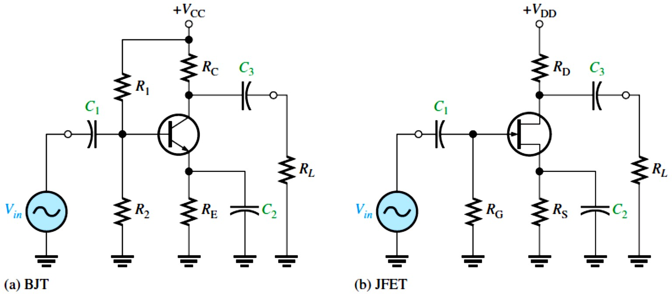
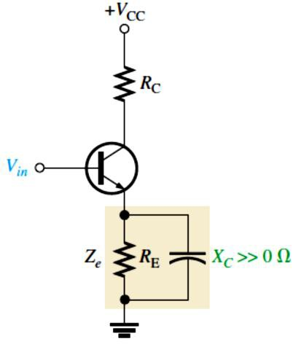
with 𝑅� in series with 𝑅_{C} or 𝑅_{D}. A lead circuit is an RC circuit in which the output voltage across R leads the input voltage in phase.
FIGURE 10-1: Examples of capacitively coupled BJT and FET amplifiers.
Effect of Bypass Capacitors: At lower frequencies, the reactance of the bypass capacitor, �₂ in Figure 10-1, becomes significant and the emitter (or FET source terminal) is no longer at ac ground. The capacitive reactance �_{𝐶2} in parallel with 𝑅_{E} (or 𝑅_{S}) creates an impedance that reduces the gain. This is illustrated in Figure 10-2. For example, when the frequency is sufficiently high, �_{𝐶}≅ 0 Ω and the voltage gain of the CE amplifier is �� = 𝑅_{C}⁄𝑟´�. At lower frequencies, �_{𝐶}≫ 0 Ω and the voltage gain is �� = 𝑅_{C}⁄(𝑟´� + 𝑍� ).
FIGURE 10-2: Nonzero reactance of the bypass capacitor in parallel with 𝑅_{E} creates an emitter impedance, (𝑍�), which reduces the voltage gain.
Effect of Internal Transistor Capacitances: At high frequencies, the coupling and bypass capacitors become effective ac shorts and do not affect an amplifier’s response.
Internal transistor junction capacitances, however, do come into play, reducing an amplifier’s gain and introducing phase shift as the signal frequency increases. Figure 10-3 shows the internal pn junction capacitances for both a bipolar junction transistor and a JFET.

Slide 3
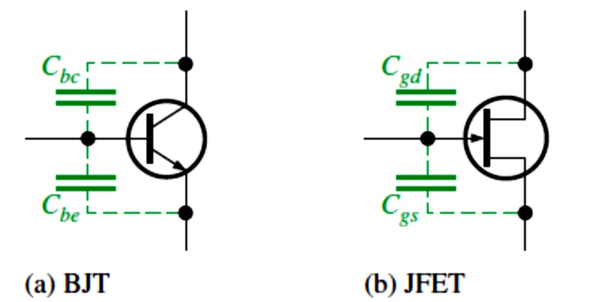
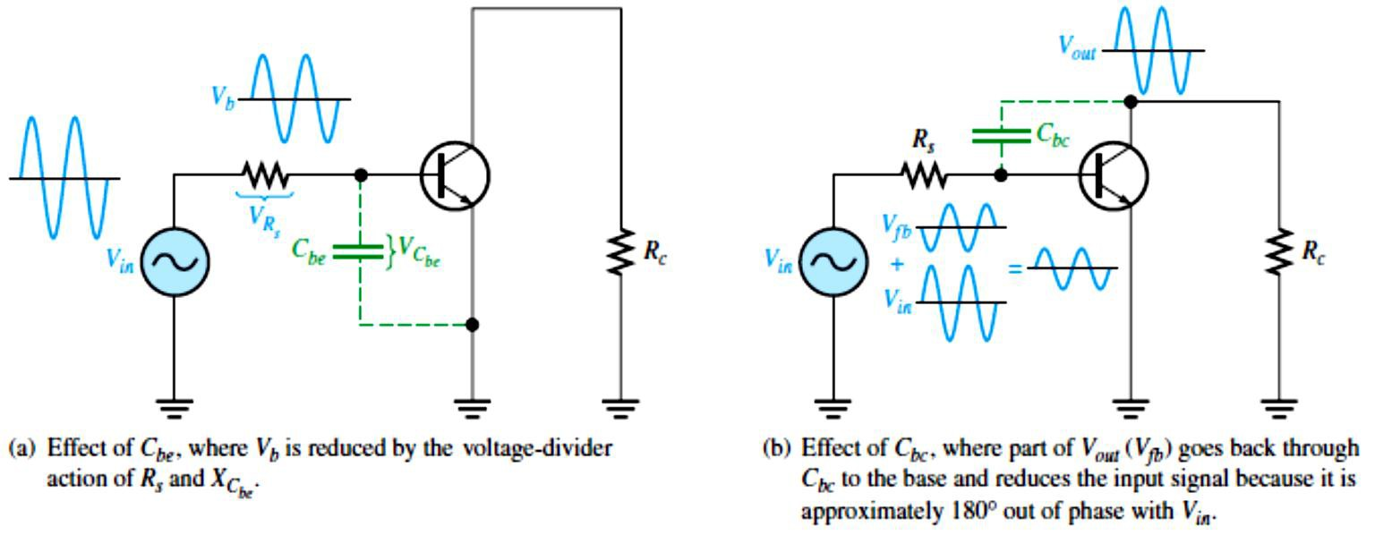
In the case of the BJT, ��� is the base-emitter junction capacitance and ��� is the base-collector junction capacitance. In the case of the JFET, �_{g�} is the capacitance between gate and source and �_{g�} is the capacitance between gate and drain.
FIGURE 10-3: Internal transistor capacitances.
Datasheets often refer to the BJT capacitance ��� as the output capacitance, often designated
��� . The capacitance ��� is often designated as the input capacitance �_{𝑖�} . Datasheets for FETs normally specify input capacitance �_{𝑖��} and reverse transfer capacitance ����. From these, �_{g�}
and �_{g�} can be calculated, as we will see in Section 10.4.
At lower frequencies, the internal capacitances have a very high reactance because of their low capacitance value (usually only a few picofarads) and the low frequency value. Therefore, they look like opens and have no effect on the transistor’s performance.
As the frequency goes up, the internal capacitive reactances go down, and at some point they begin to have a significant effect on the transistor’s gain. When the reactance of ��� (or �_{g�})
becomes small enough, a significant amount of the signal voltage is lost due to a voltage- divider effect of the signal source resistance and the reactance of ���, as illustrated in Figure 10-4(a). When the reactance of ��� (or �_{g�} ) becomes small enough, a significant amount of
output signal voltage is fed back out of phase with the input (negative feedback), thus effectively reducing the voltage gain. This is illustrated in Figure 10-4(b).
FIGURE 10-4: AC equivalent circuit for a BJT amplifier showing effects of the internal capacitances ��� and ���.

Slide 4
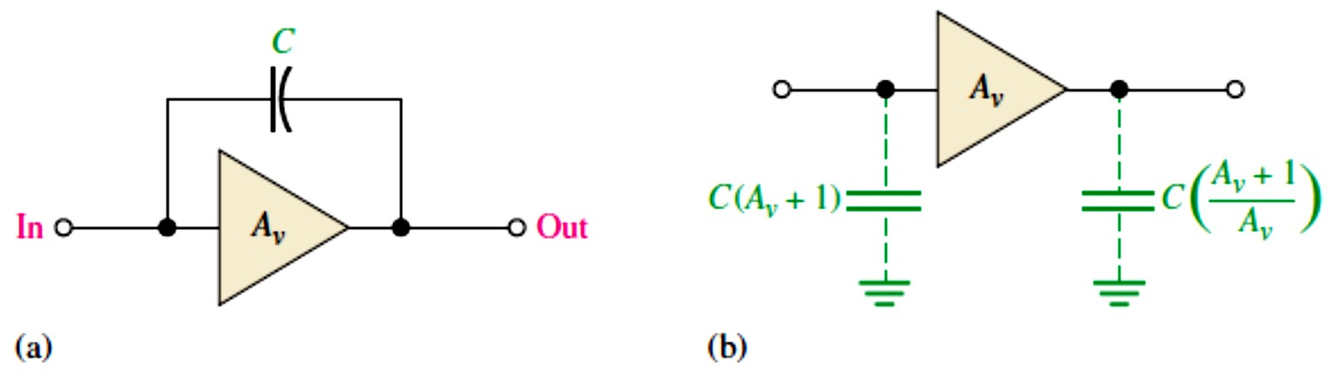
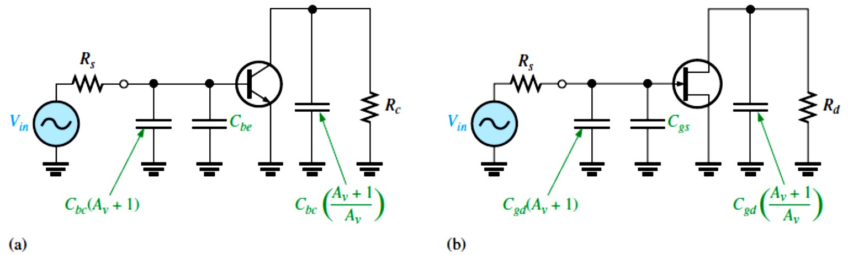
Miller’s Theorem: is used to simplify the analysis of inverting amplifiers at high frequencies where the internal transistor capacitances are important.
The capacitance ��� in BJTs (�_{g�} in FETs) between the input (base or gate) and the output
(collector or drain) is shown in Figure 10-5(a) in a generalized form. �� is the absolute voltage gain of the inverting amplifier at midrange frequencies, and C represents either ��� or �_{g�} .
FIGURE 10-5: General case of Miller input and output capacitances. C represents ��� or �_{g�} .
Miller’s theorem states that C effectively appears as a capacitance from input to ground, as shown in Figure 10-5(b), which can be expressed as follows:
���(������) ^{= �(�}� ^{+ �)}
Equation 10– 1
This formula shows that ��� (or �_{g�} ) has a much greater impact on input capacitance than its actual value. For example, if ��� = 6 pF and the amplifier gain is 50, then �_{𝑖�(�𝑖����)} = 306 pF. Figure 10-6 shows how this effective input capacitance appears in the actual ac equivalent circuit in parallel with ��� (or �_{g�}).
FIGURE 10-6: Amplifier ac equivalent circuits showing internal capacitances and effective Miller capacitances.
Miller’s theorem also states that C effectively appears as a capacitance from output to ground, as shown in Figure 10-5(b), which can be expressed as follows:
����(������) ^{= �((�}� ^{+ �)⁄�}�⁾
Equation 10– 2
This formula indicates that if the voltage gain is 10 or greater, �_{���(�𝑖����)} is approximately equal to ��� or �_{g�} because �� + 1⁄�� is approximately equal to 1. Figure 10-6 also shows how this effective output capacitance appears in the ac equivalent circuit for BJTs and
FETs.

Slide 5
10.2 The Decibel
The decibel (dB) is a unit of logarithmic gain measurement and is commonly used to express amplifier response.
The use of decibels to express gain was introduced in Lecture 6. The decibel unit is important in amplifier measurements.
The basis for the decibel unit stems from the logarithmic response of the human ear to the intensity of sound.
The decibel is a logarithmic measurement of the ratio of one power to another or one voltage to another. Power gain is expressed in decibels (dB) by the following formula:
�_{�(𝐝�)} = �� 𝐥�𝐠��
Equation 10– 3
where �� is the actual power gain, ���� ⁄�_{𝑖�}. Voltage gain is expressed in decibels by the following formula:
�_{�(𝐝�)} = �� 𝐥�𝐠��
Equation 10– 4
If �� is greater than 1, the dB gain is positive. If �� is less than 1, the dB gain is negative and is usually called attenuation. We can use the LOG key on our calculator when working with these formulas.
EXAMPLE 10-1: Express each of the following ratios in dB:
(a) ���� ⁄�_{𝑖�} = 250 (b) ���� ⁄�_{𝑖�} = 100 (c) �� = 10
Solution (a)�_{�(dB)} = 10 log(250) = 24 dB
(c)�_{�(dB)} = 20 log(10) = 20 dB
(e)�_{�(dB)} = 20 log(0.707) = −3 dB
(d) �� = 0.5 (e) ���� ⁄�_{𝑖�} = 0.707 (b)�_{�(dB)} = 10 log(100) = 20 dB (d)�_{�(dB)} = 10 log(0.5) = −3 dB
0 dB Reference: It is often convenient in amplifiers to assign a certain value of gain as the 0 dB reference. This does not mean that the actual voltage gain is 1 (which is 0 dB); it means that the reference gain, no matter what its actual value, is used as a reference with which to compare other values of gain and is therefore assigned a 0 dB value.
Many amplifiers exhibit a maximum gain over a certain range of frequencies and a reduced gain at frequencies below and above this range.
The maximum gain occurs for the range of frequencies between the upper and lower critical frequencies and is called the midrange gain, which is assigned a 0 dB value. Any value of
gain below midrange can be referenced to 0 dB and expressed as a negative dB value. For example, if the midrange voltage gain of a certain amplifier is 100 and the gain at a certain frequency below midrange is 50, then this reduced voltage gain can be expressed as
20 log(50⁄100) = 20 log(0.5) = −6 dB. This indicates that it is 6 dB below the 0 dB reference. Halving the output voltage for a steady input voltage is always a 6 dB reduction in
the gain. Correspondingly, a doubling of the output voltage is always a 6 dB increase in the

Slide 6
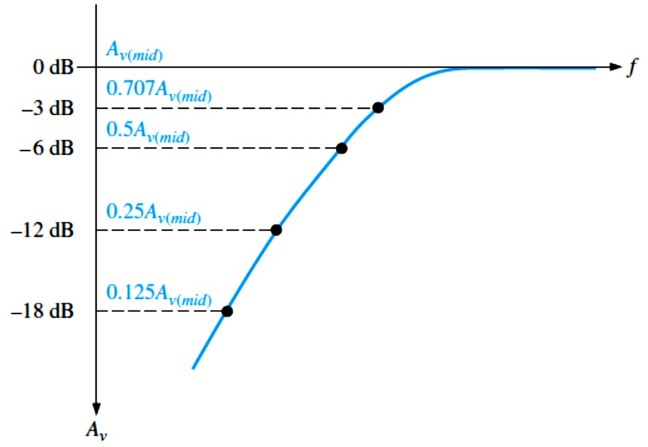
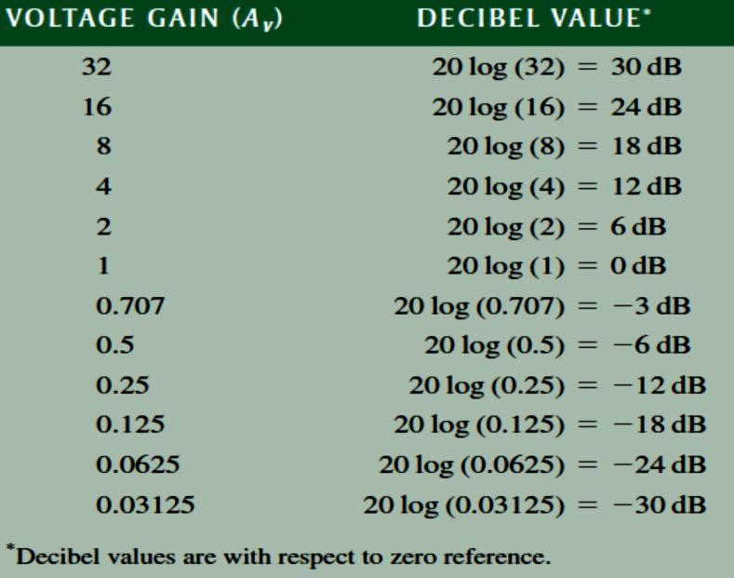
gain. Figure 10-7 illustrates a normalized gain-versus-frequency curve showing several dB points. The term normalized means that the midrange voltage gain is assigned a value of 1 or 0 dB.
FIGURE 10-7: Normalized
voltage gain versus frequency curve.
Table 10-1 shows how doubling or halving voltage gains translates into decibel values. In the table, every time the voltage gain is doubled, the decibel value increases by 6 dB, and every time the gain is halved, the dB value decreases by 6 dB.
TABLE 10-1: Decibel values corresponding to doubling and halving of the voltage gain.
Critical Frequency: also known as cutoff frequency or corner frequency is a frequency at which the output power drops to one-half of its midrange value. This corresponds to a 3 dB reduction in the power gain, as expressed in dB by the following formula:
�_{�(dB)} = 10 log(0.5) = −3 dB
Also, at the critical frequencies the voltage gain is 70.7% of its midrange value and is expressed in dB as
�_{�(𝐝�)} = �� 𝐥�𝐠(�. 𝟕��) = −� 𝐝�

Slide 7
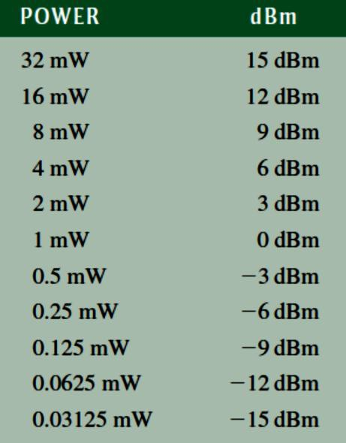
EXAMPLE 10-2: A certain amplifier has a midrange rms output voltage of 10 V. What is the rms output voltage for each of the following dB gain reductions with a constant rms input voltage? (a) −3 dB (b) −6 dB (c) −12dB (d) −24 dB
Solution Multiply the midrange output voltage by the voltage gain corresponding to the specified decibel value in Table 10-1.
(a) At −3 dB, ���� = 0.707(10 V) = 7.07 V
Or At −3 dB, �_{�(dB)} = 20 log ��
�� = 10^{(𝐴𝑣(dB)⁄20)} = 10^{(−3⁄20)} = 0.707
�� = 0.707 �_{�(�𝑖�)}
���� ⁄�𝑖� ^{= 0.707 �}���(�𝑖�)⁄�𝑖�(�𝑖�)
Since rms input voltage is constant, ���� = 0.707�_{���(�𝑖�)} = 0.707(10V) = 7.07 V
(b) At −6 dB, ���� = 0.5(10 V) = 5 V
(c) At −12 dB, ���� = 0.25(10 V) = 2.5 V
(d) At −24 dB, ���� = 0.0625(10 V) = 0.625 V
Power Measurement in dBm: The dBm is a unit for measuring power levels referenced to 1 mW. Positive dBm values represent power levels above 1 mW, and negative dBm values represent power levels below 1 mW.
Because the decibel (dB) can be used to represent only power ratios, not actual power, the dBm provides a convenient way to express actual power output of an amplifier or other device. Each 3 dBm increase corresponds to a doubling of the power, and a 3 dBm decrease
corresponds to a halving of the power.
To state that an amplifier has a 3 dB power gain indicates only that the output power is twice the input power and nothing about the actual output power.
To indicate actual output power, the dBm can be used. For example, 3 dBm is equivalent to 2 mW because 2 mW is twice the 1 mW reference. 6 dBm is equivalent to 4 mW, and so on. Likewise, −3 dB is the same as 0.5 mW. Table 10-2 shows several values of power in terms of dBm.
TABLE 10-2: Power in terms of dBm.

Slide 8
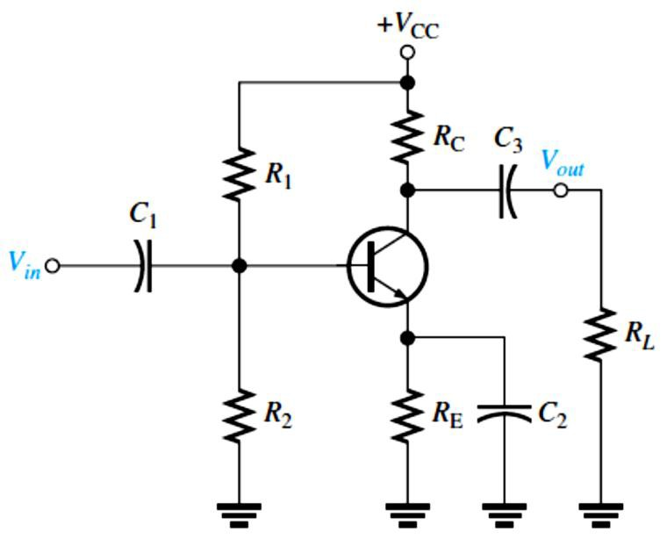
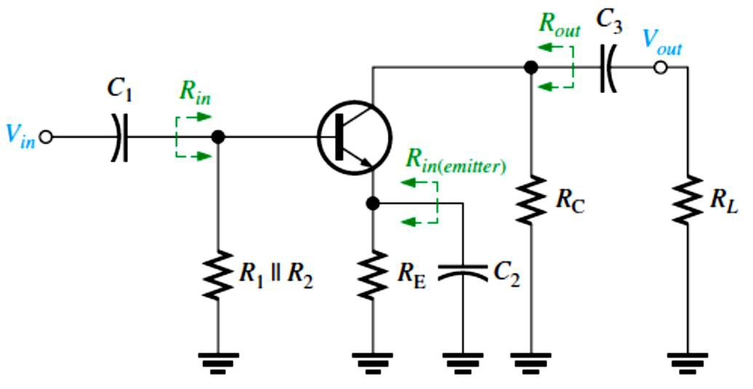
10.3 Low-Frequency Amplifier Response
The voltage gain and phase shift of capacitively coupled amplifiers are affected when the signal frequency is below a critical value. Frequency responses of both BJT and FET capacitively coupled amplifiers are discussed.
BJT Amplifiers: A capacitively coupled CE amplifier is shown in Figure 10-8. Assuming that the coupling and bypass capacitors are ideal shorts at the midrange signal frequency, we
can determine the midrange voltage gain using Equation 10-5, where 𝑅� = 𝑅_{C} ∥ 𝑅�.
��(���) ^{= 𝑹}�⁄�´�
Equation 10– 5
If a swamping resistor (𝑅_{E1}) is used, it appears in series with 𝑟´� and the equation becomes
��(�𝑖�) ^{= 𝑅}�^{⁄(𝑟´}� ^{+ 𝑅}E1⁾
FIGURE 10-8: A capacitively coupled BJT amplifier.
The BJT amplifier in Figure 10-8 has three high-pass RC circuits that affect its gain as the frequency is reduced below midrange. These are shown in the low-frequency ac equivalent circuit in Figure 10-9. Unlike the ac equivalent circuit used in previous Lectures, which represented midrange response (�_{𝐶}≅ 0 Ω), the low-frequency equivalent circuit retains the coupling and bypass capacitors because �_{𝐶}is not small enough to neglect when the signal frequency is sufficiently low.
FIGURE 10-9: The low-frequency ac equivalent circuit of the amplifier in Figure 10-8 consists of three high- pass RC circuits.

Slide 9
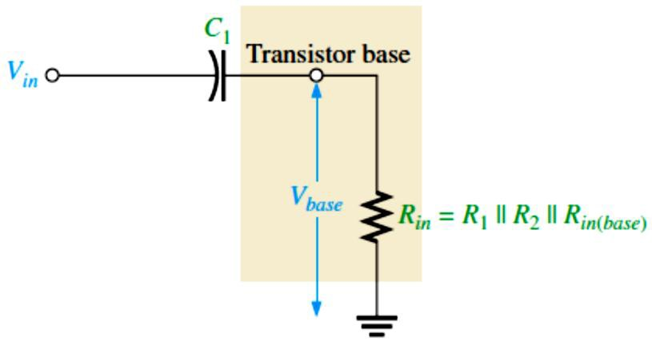
One RC circuit is formed by the input coupling capacitor �₁ and the input resistance of the amplifier. The second RC circuit is formed by the output coupling capacitor �₃, the resistance looking in at the collector (𝑅���), and the load resistance. The third RC circuit that affects the low-frequency response is formed by the emitter-bypass capacitor �₂ and the resistance looking in at the emitter.
The Input RC Circuit: for the BJT amplifier in Figure 10-8 is formed by �₁ and the amplifier’s input resistance and is shown in Figure 10-10. As the signal frequency decreases,
�_{𝐶1} increases. This causes less voltage across the input resistance of the amplifier at the base because more voltage is dropped across �₁ and because of this, the overall voltage gain of the
amplifier is reduced. The base voltage for the input RC circuit in Figure 10–10 (neglecting the internal resistance of the input signal source) can be stated as
����� ^{= (𝑅}𝑖�^{⁄√𝑅}𝑖�^{2 + �}𝐶1^{2) �}𝑖�
FIGURE 10-10: Input RC circuit formed by the input coupling capacitor and the amplifier’s input resistance.
A critical point in the amplifier’s response occurs when the output voltage is 70.7% of its midrange value. This condition occurs in the input RC circuit when �_{𝐶1} = 𝑅_{𝑖�}.
����� = (𝑅_{𝑖�}⁄√𝑅_{𝑖�}² + 𝑅_{𝑖�}²) �_{𝑖�} = (𝑅_{𝑖�}⁄√2𝑅_{𝑖�}²) �_{𝑖�} = (𝑅_{𝑖�}⁄(√2 𝑅_{𝑖�}))�_{𝑖�} = (1⁄√2)�_{𝑖�} = 0.707�_{𝑖�}
In terms of measurement in decibels, 20 log(����� ⁄�_{𝑖�}) = 20 log(0.707) = −3 dB
Lower Critical Frequency: The condition where the gain is down 3 dB is logically called the
−3 𝑑� point of the amplifier response; the overall gain is 3 dB less than at midrange frequencies because of the attenuation (gain less than 1) of the input RC circuit. The frequency,
��� , at which this condition occurs is called the lower critical frequency (also known as the lower cutoff frequency, lower corner frequency, or lower break frequency) and can be calculated as follows:
�𝐶1 ^{= 1⁄(2𝜋�}��(𝑖����)�1^{) = 𝑅}𝑖�
���(�����) ^{= �⁄(��𝑹}����⁾
Equation 10– 6
If the resistance of the input source is taken into account, Equation 10-6 becomes
�_{��(𝑖����)} = 1⁄(2𝜋(𝑅� + 𝑅_{𝑖�})�₁)

Slide 10
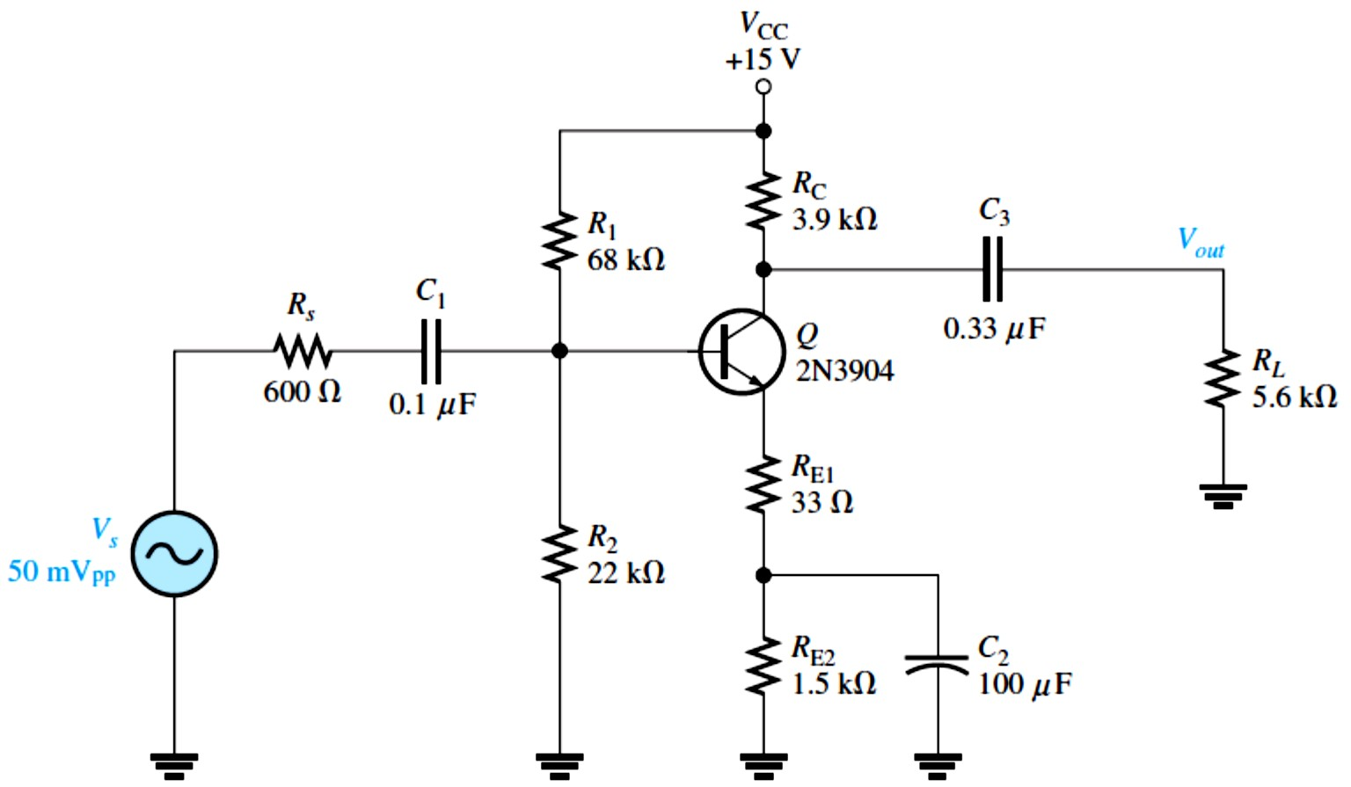
EXAMPLE 10-3: For the circuit in Figure 10-11, calculate the lower critical frequency due to the input RC circuit. Assumed 𝑟´� = 9.6 Ω and 𝛽= 200. Notice that a swamping resistor, 𝑅_{E1}, is used.
FIGURE 10-11
Solution The input resistance is
𝑅_{𝑖�} = 𝑅₁ ∥ 𝑅₂ ∥ (𝛽(𝑟´� + 𝑅_{E1})) = 68 kΩ ∥ 22 kΩ ∥ (200(9.6 Ω + 33 Ω)) = 5.63 kΩ
The lower critical frequency is
�_{��(𝑖����)} = 1⁄(2𝜋𝑅_{𝑖�}�₁) = 1⁄(2𝜋(5.63 kΩ)(0.1 𝜇F)) = 282 Hz
Voltage Gain Roll-Off at Low Frequencies: As we have seen, the input RC circuit reduces the overall voltage gain of an amplifier by 3 dB when the frequency is reduced to the critical value �� . As the frequency continues to decrease below �� , the overall voltage gain also continues to decrease. The rate of decrease in voltage gain with frequency is called roll-off. For each ten times reduction in frequency below �� , there is a 20 dB reduction in voltage gain.
Let’s consider a frequency that is one-tenth of the critical frequency (𝑓= 0.1�� ). Since �_{𝐶1} =
𝑅_{𝑖�} at �� , then �_{𝐶1} = 10 𝑅_{𝑖�} at 0.1�� because of the inverse relationship of �_{𝐶1} and 𝑓. The attenuation of the input RC circuit is, therefore,
Attenuation = ����� ⁄�_{𝑖�} = 𝑅_{𝑖�}⁄√𝑅_{𝑖�}² + �_{𝐶1}² = 𝑅_{𝑖�}⁄√𝑅_{𝑖�}² + (10 𝑅_{𝑖�})²
= 𝑅_{𝑖�}⁄√𝑅_{𝑖�}² + 100𝑅_{𝑖�}² = 𝑅_{𝑖�}⁄√𝑅_{𝑖�}²(1 + 100) = 𝑅_{𝑖�}⁄(𝑅_{𝑖�}√101)
= 1⁄√101 ≅ 1⁄10 = 0.1
The dB attenuation is 20 log(����� ⁄�_{𝑖�}) = 20 log(0.1) = −20 dB
10

Slide 11
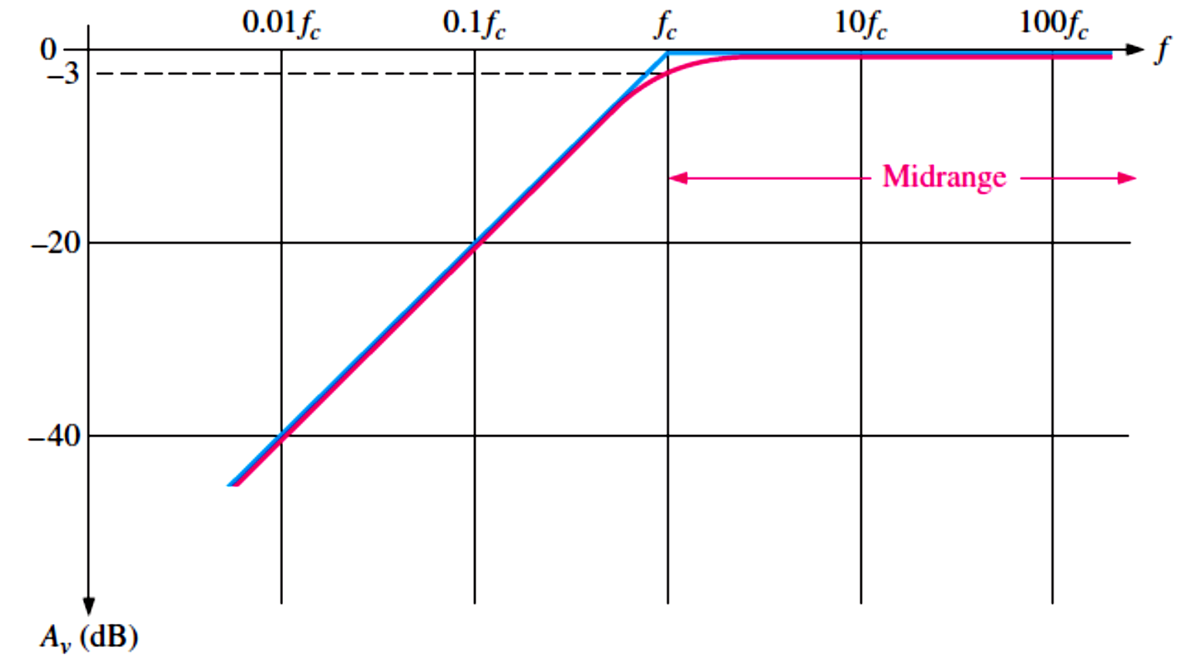
The Bode Plot: A ten-times change in frequency is called a decade. So, for the input RC circuit, the attenuation is reduced by 20 dB for each decade that the frequency decreases below the critical frequency. This causes the overall voltage gain to drop 20 dB per decade.
A plot of dB voltage gain versus frequency on semilog graph paper (logarithmic horizontal axis scale and a linear vertical axis scale) is called a Bode plot. A generalized Bode plot for an input RC circuit appears in Figure 10-12. The ideal response curve is shown in blue. It is
flat (0 dB) down to the critical frequency, at which point the gain drops at −20 dB⁄decade as shown. Above �� are the midrange frequencies. The actual response curve is shown in red. It decreases gradually beginning in midrange and is down to −3 dB at the critical frequency. Often, the ideal response is used to simplify amplifier analysis. As previously mentioned, the critical frequency at which the curve “breaks” into a −20 dB⁄decade drop is sometimes called the lower break frequency.
FIGURE 10-12: Bode plot. (Blue is ideal; red is actual.)
Sometimes, the voltage gain roll-off of an amplifier is expressed in dB⁄octave rather than dB⁄decade. An octave corresponds to a doubling or halving of the frequency. For example, an increase in frequency from 100 Hz to 200 Hz is an octave. Likewise, a decrease in frequency from 100 kHz to 50 kHz is also an octave. A rate of −20 dB⁄decade is approximately equivalent to −6 dB⁄octave, a rate of −40 dB⁄decade is approximately equivalent to
−12 dB⁄octave, and so on.
EXAMPLE 10-4: The midrange voltage gain of a certain amplifier is 100. The input RC circuit has a lower critical frequency of 1 kHz. Determine the actual voltage gain at 𝑓=1 kHz, 𝑓=100 Hz, and 𝑓=10 Hz.
Solution When 𝑓=1 kHz, the voltage gain is 3 dB less than at midrange. At −3 dB the voltage gain is reduced by a factor of 0.707.
�� = 0.707 �_{�(�𝑖�)} = (0.707)(100) = 70.7

Slide 12
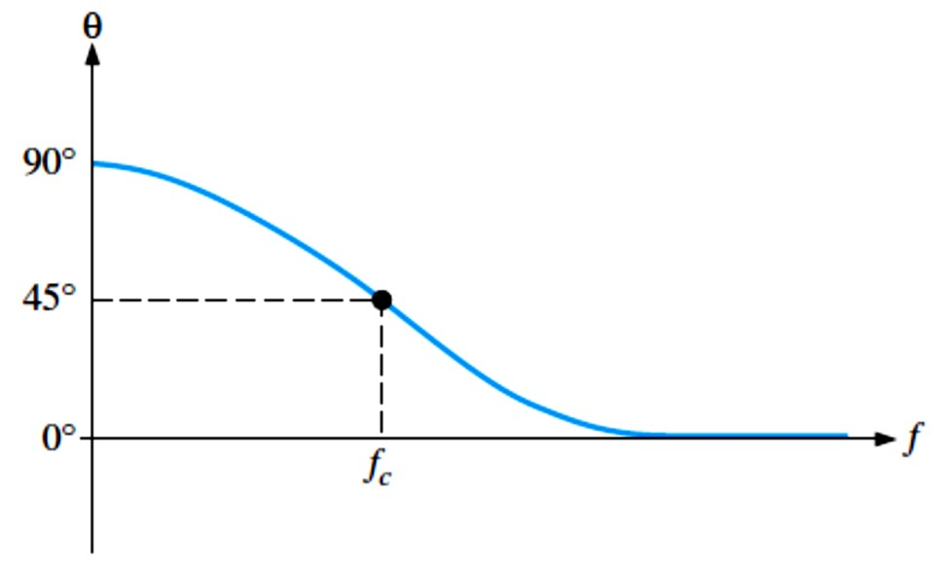
When 𝑓= 100 Hz = 0.1 ��, the voltage gain is 20 dB less than at �� . The voltage gain at −20 dB
is one-tenth of that at the midrange frequencies.
�� = 0.1 �_{�(�𝑖�)} = (0.1)(100) = 10
When 𝑓= 10 Hz = 0.01 ��, the voltage gain is 20 dB less than at 𝑓= 0.1 �� or −40 dB. The voltage gain at −40 dB is one-tenth of that at −20 dB or one-hundredth that at the midrange frequencies.
�� = 0.01 �_{�(�𝑖�)} = (0.01)(100) = 1
Phase Shift in the Input RC Circuit: In addition to reducing the voltage gain, the input RC circuit also causes an increasing phase shift through an amplifier as the frequency decreases. At midrange frequencies, the phase shift through the input RC circuit is approximately zero because the capacitive reactance, �_{𝐶1}, is approximately 0 Ω. At lower frequencies, higher values of �_{𝐶1} cause a phase shift to be introduced, and the output voltage of the RC circuit leads the input voltage. As we learned in ac circuit theory, the phase angle in an input RC circuit is expressed as
𝜽= 𝐭𝐚�^{−�}(���⁄𝑹��)
For midrange frequencies, �_{𝐶1} ≅ 0 Ω, so
𝜃= tan⁻¹(0 Ω⁄𝑅_{𝑖�}) = tan⁻¹(0) = 0°
At the critical frequency, �_{𝐶1} = 𝑅_{𝑖�}, so
𝜃= tan⁻¹(𝑅_{𝑖�}⁄𝑅_{𝑖�}) = tan⁻¹(1) = 45°
At a decade below the critical frequency, �_{𝐶1} = 10𝑅_{𝑖�}, so
𝜃= tan⁻¹(10𝑅_{𝑖�}⁄𝑅_{𝑖�}) = tan⁻¹(10) = 84.3°
A continuation of this analysis will show that the phase shift through the input RC circuit approaches 90° as the frequency approaches zero. A plot of phase angle versus frequency is shown in Figure 10-13. The result is that the voltage at the base of the transistor leads the input signal voltage in phase below midrange, as shown in Figure 10-14.
Equation 10– 7
FIGURE 10-13: Phase angle versus frequency for the input RC circuit.

Slide 13
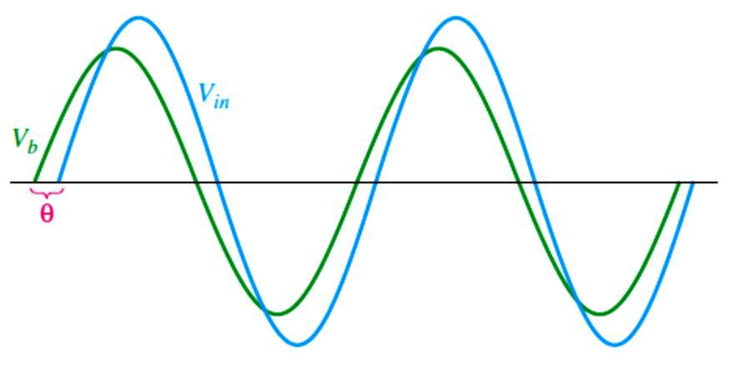
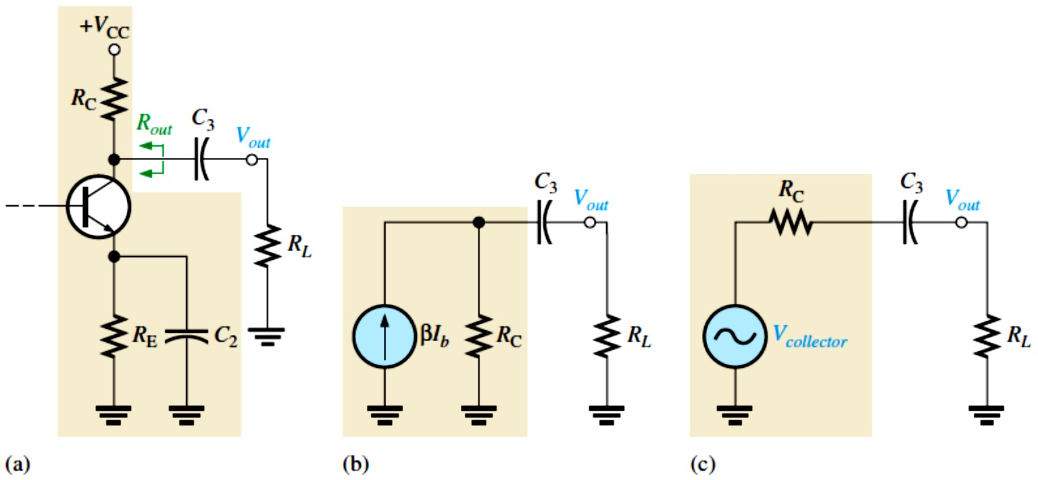
FIGURE 10-14: The input RC circuit causes the base voltage to lead the input voltage below midrange by an amount equal to the circuit phase angle, 𝜃.
The Output RC Circuit: The second high-pass RC circuit in the BJT amplifier of Figure 10- 8 is formed by the coupling capacitor �₃, the resistance looking in at the collector, and the load resistance 𝑅�, as shown in Figure 10-15(a). In determining the output resistance, looking in at the collector, the transistor is treated as an ideal current source (with infinite internal resistance), and the upper end of 𝑅_{C} is effectively at ac ground, as shown in Figure 10-15(b). Therefore, thevenizing the circuit to the left of capacitor �₃ produces an equivalent voltage source equal to the collector voltage and a series resistance equal to 𝑅_{C}, as shown in Figure 10-15(c). The lower critical frequency of this output RC circuit is
�_{��(������)} = �⁄(��(𝑹� + 𝑹�)��)
where 𝑅��� = 𝑅_{C} + 𝑅�.
Equation 10– 8
FIGURE 10-15:
Development of the equivalent low-
frequency output
RC circuit.
The effect of the output RC circuit on the amplifier voltage gain is similar to that of the input RC circuit. As the signal frequency decreases, �_{𝐶3} increases. This causes less voltage across the load resistance because more voltage is dropped across �₃. The signal voltage is reduced by a factor of 0.707 when frequency is reduced to the lower critical value, ��� , for the circuit. This corresponds to a 3 dB reduction in voltage gain.
EXAMPLE 10-5: For the circuit from Example 10-3 and shown in Figure 10-16, calculate the lower critical frequency due to the output RC circuit.

Slide 14
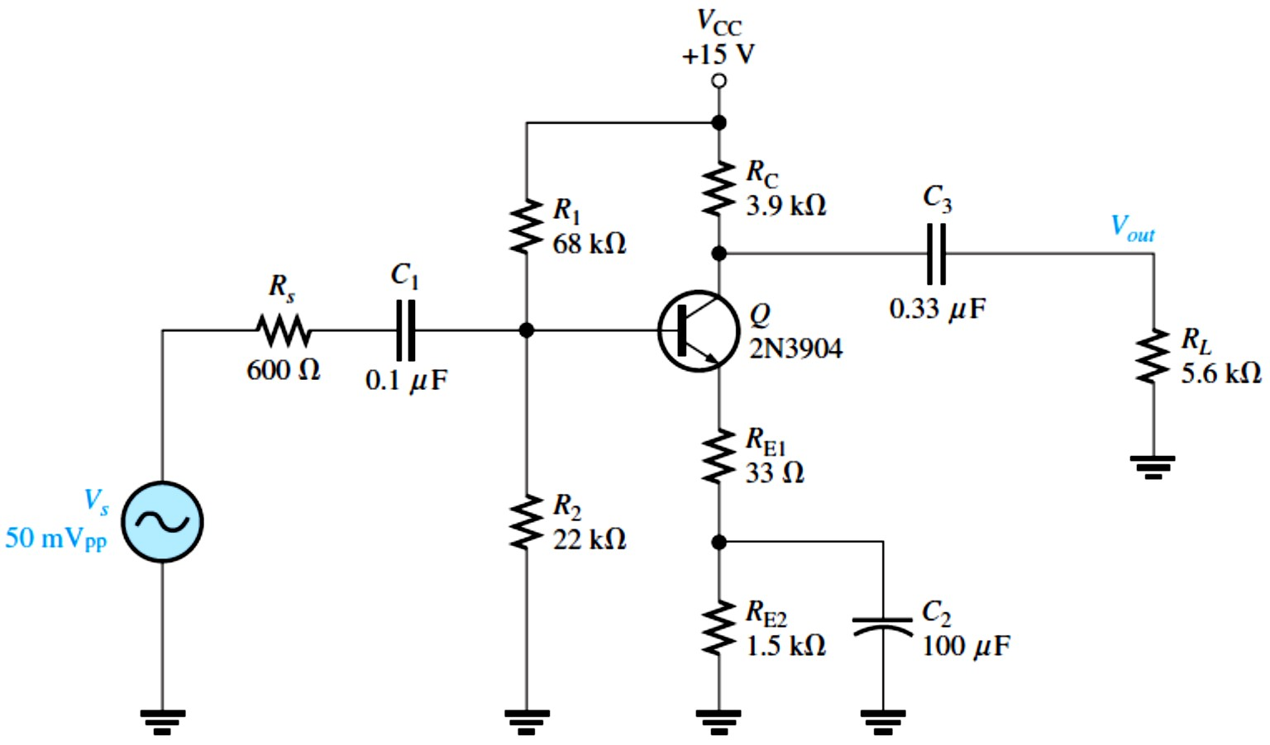
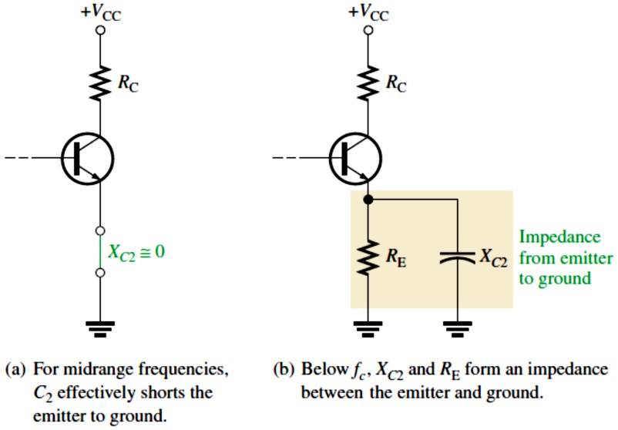
FIGURE 10-16
Solution The resistance in the output RC circuit is 𝑅��� = 𝑅_{C} + 𝑅� = 3.9 kΩ + 5.6 kΩ = 9.5 kΩ
The lower critical frequency is
�_{��(������)} = 1⁄(2𝜋(𝑅_{C} + 𝑅�)�₃) = 1⁄(2𝜋(9.5 kΩ)(0.33 𝜇F)) = 50.8 Hz
Phase Shift in the Output RC Circuit: The phase angle in the output RC circuit is
𝜽= 𝐭𝐚�^{−�}(���⁄𝑹���) = 𝐭𝐚�^{−�}(���⁄(𝑹� + 𝑹�))
Equation 10– 9
𝜃≅ 0° for the midrange frequencies and approaches 90° as the frequency approaches zero (�_{𝐶3} approaches infinity). At the critical frequency �� , the phase shift is 45°.
The Bypass RC Circuit: The third RC circuit that affects the low-frequency gain of the BJT amplifier in Figure 10–8 includes the bypass capacitor �₂. As illustrated in Figure 10–17(a) for midrange frequencies, it is assumed that �_{𝐶2} ≅ 0 Ω, effectively shorting the emitter to
ground so that the amplifier gain is 𝑅�⁄𝑟´�, as we already know. As the frequency is reduced,
�_{𝐶2} increases and no longer provides a sufficiently low reactance to effectively place the emitter at ac ground, as shown in part (b). Because the impedance from emitter to ground
increases, the gain decreases. In this case, 𝑅� in the formula, �� = 𝑅�⁄(𝑟´� + 𝑅� ), is replaced by an impedance formed by 𝑅_{E} in parallel with �_{𝐶2}.
FIGURE 10-17: At low frequencies, �_{𝐶2} in parallel with 𝑅_{E} creates an impedance that reduces the voltage gain.

Slide 15
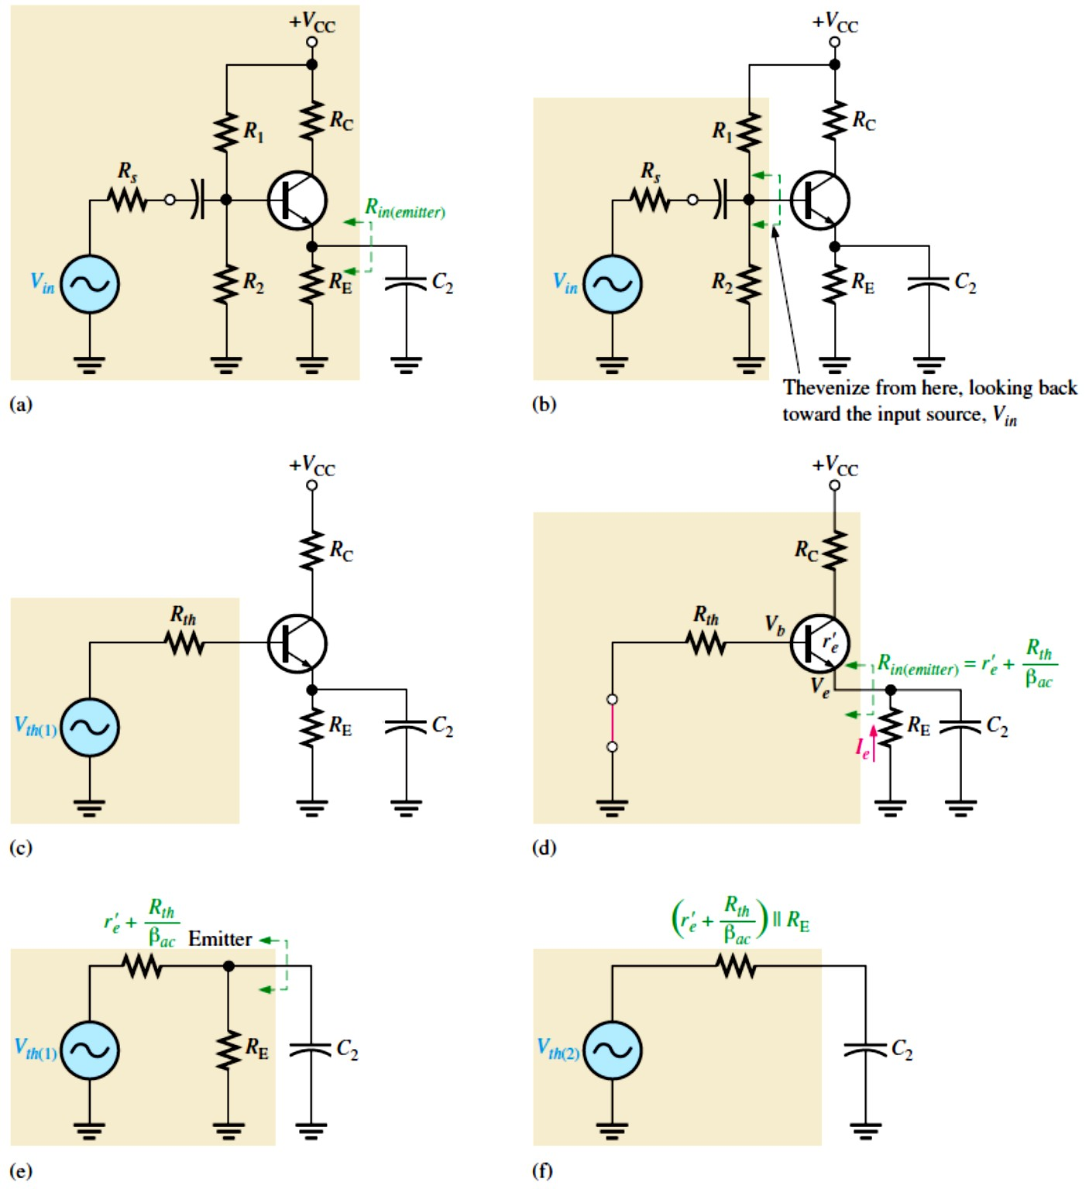
The bypass RC circuit is formed by �₂ and the resistance looking in at the emitter, 𝑅_{𝑖�(��𝑖����)}, as shown in Figure 10-18(a). The resistance looking in at the emitter is derived as follows. First, Thevenin’s theorem is applied looking from the base of the transistor toward the input source �_{𝑖�}, as shown in Figure 10-18(b). This results in an equivalent resistance (𝑅_{�ℎ}) and an equivalent voltage source (�_{�ℎ(1)}) in series with the base, as shown in Figure 10-18(c). The resistance looking in at the emitter is determined with the equivalent input source shorted, as shown in Figure 10-18(d), and is expressed as follows:
𝑅_{𝑖�(��𝑖����)} = 𝑟´� + (��⁄𝐼� ) ≅ 𝑟´� + �� ⁄(𝛽�� 𝐼� ) = 𝑟´� + (𝐼� 𝑅_{�ℎ})⁄(𝛽�� 𝐼� )
^{𝑹}��(�������) ^{= �´}� ^{+ 𝑹}��^{⁄𝜷}��
Equation 10– 10
Looking from the capacitor �₂, 𝑟´� + 𝑅_{�ℎ}⁄𝛽�� is in parallel with 𝑅_{E}, as shown in Figure 10- 18(e). Thevenizing again, we get the equivalent RC circuit shown in Figure 10-18(f). The lower critical frequency for this equivalent bypass RC circuit is
���(�𝒚����) ⁼ _{��[(�´}
�
Equation 10– 11
� + 𝑹��⁄𝜷��) ∥ 𝑹�]��
If a swamping resistor is used, the equation for 𝑅_{𝑖�(��𝑖����)} becomes
^{𝑅}𝑖�(��𝑖����) ^{= 𝑟´}� ^{+ 𝑅}E1 ^{+ 𝑅}�ℎ^{⁄𝛽}��
FIGURE 10-18: Development of the equivalent bypass RC circuit.

Slide 16
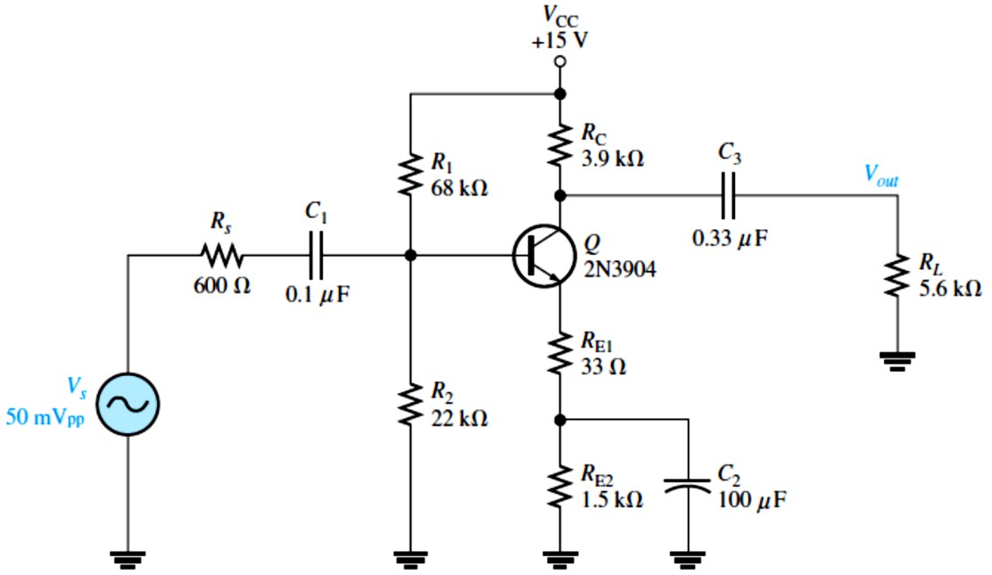
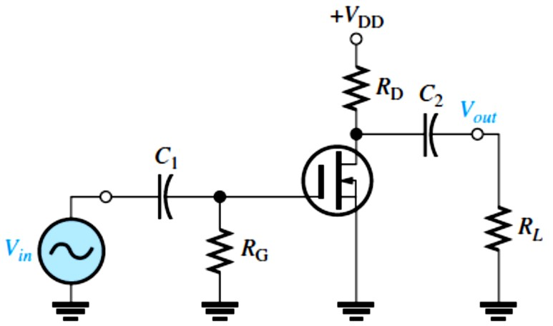
EXAMPLE 10-6: For the circuit from Example 10-3 and shown in Figure 10-19, calculate the lower critical frequency due to the bypass RC circuit. Assume 𝑟´� = 9.6 Ω and 𝛽= 200.
FIGURE 10-19
Solution The resistance in the emitter bypass circuit is 𝑅_{�ℎ} = 𝑅₁ ∥ 𝑅₂ ∥ 𝑅�
𝑅_{𝑖�(��𝑖����)} = 𝑟´� + 𝑅_{E1} + 𝑅_{�ℎ}⁄𝛽�� = 9.6 Ω + 33 Ω + (68 kΩ ∥ 22 kΩ ∥ 600 Ω)⁄200
= 45.5 Ω
The lower critical frequency is
1 1
���(�𝑦����) ⁼
= = 36.0 Hz
^{2𝜋[𝑅}𝑖�(��𝑖����) ^{∥ 𝑅}E2]�2
2𝜋[45.5 Ω ∥ 1.5 kΩ](100 𝜇F)
FET Amplifiers: A zero-biased D-MOSFET amplifier with capacitive coupling on the input and output is shown in Figure 10-20. As we learned in Lecture 9, the midrange voltage gain of a zero-biased amplifier is
��(�𝑖�) ^{= g}�^{𝑅}�
This is the gain at frequencies high enough so that the capacitive reactances are approximately
zero.
The amplifier in Figure 10-20 has only two high-pass RC circuits that influence its low- frequency response. One RC circuit is formed by the input coupling capacitor �₁ and the input
resistance. The other circuit is formed by the output coupling capacitor �₂ and the output resistance looking in at the drain.
FIGURE 10-20: Zero-biased D-MOSFET amplifier.

Slide 17
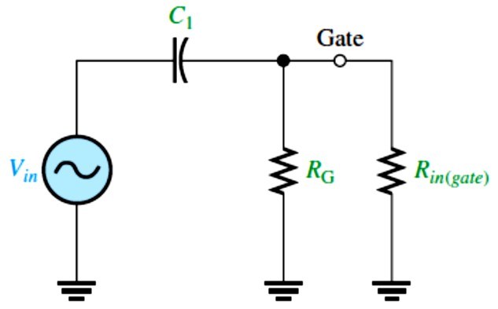
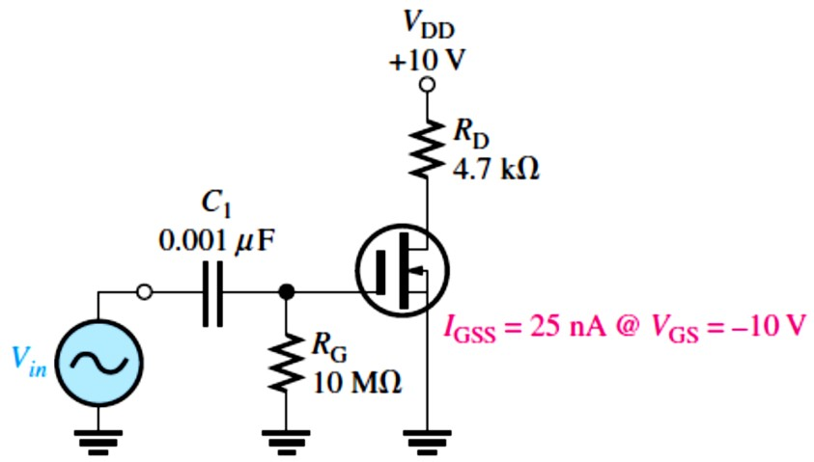
The Input RC Circuit: The input RC circuit for the FET amplifier in Figure 10-20 is shown in Figure 10-21. As in the case for the BJT amplifier, the reactance of the input coupling capacitor increases as the frequency decreases. When �_{𝐶1} = 𝑅_{𝑖�}, the gain is down 3 dB below its midrange value.
FIGURE 10-21: Input RC circuit.
The lower critical frequency is �_{��(𝑖����)} = 1⁄(2𝜋𝑅_{𝑖�}�₁)
The input resistance is 𝑅_{𝑖�} = 𝑅_{G} ∥ 𝑅_{𝑖�(����)}
where 𝑅_{𝑖�(����)} is determined from
datasheet information as 𝑅_{𝑖�(����)} = |�_{GS}⁄𝐼_{GSS}|
Therefore, the lower critical frequency is
���(�����) ⁼ _{��(𝑹}
�
Equation 10– 12
∥ 𝑹)�
𝐆��(����) �
For practical work, the value of 𝑅_{𝑖�(����)} is so large it can be ignored, as will be illustrated in Example 10-7.
The gain rolls off below �� at 20 dB/decade, as previously shown. The phase angle in the low- frequency input RC circuit is
𝜽= 𝐭𝐚�^{−�}(���⁄𝑹��)
Equation 10– 13
EXAMPLE 10-7: What is the lower critical frequency of the input RC circuit in the FET amplifier of Figure 10-22?
FIGURE 10-22
Solution First, we determine 𝑅_{𝑖�}
and then we calculate �� .
𝑅_{𝑖�(����)} = |�_{GS}⁄𝐼_{GSS}| = |−10 V⁄25 nA|
𝑅_{𝑖�(����)} = 10 V⁄25 nA = 400 MΩ
𝑅_{𝑖�} = 𝑅_{G} ∥ 𝑅_{𝑖�(����)} = 10 MΩ ∥ 400 MΩ
𝑅_{𝑖�} = 9.8 MΩ
�_{��(𝑖����)} = 1⁄(2𝜋𝑅_{𝑖�}�₁) = 1⁄(2𝜋(9.8 MΩ)(0.001 𝜇F)) = 16.2 Hz
For all practical purposes, 𝑅_{𝑖�} ≅ 𝑅_{G} = 10 MΩ
And �_{��(𝑖����)} = 1⁄(2𝜋𝑅_{G}�₁) = 1⁄(2𝜋(10 MΩ)(0.001 𝜇F)) ≅ 15.9 Hz
There is very little difference in the two results. The critical frequency of the input RC circuit of a FET amplifier is usually very low because of the very high input resistance and the high value of 𝑅_{G}.
The Output RC Circuit: The second RC circuit that affects the low-frequency response of the FET amplifier in Figure 10-20 is formed by a coupling capacitor �₂ and the output

Slide 18
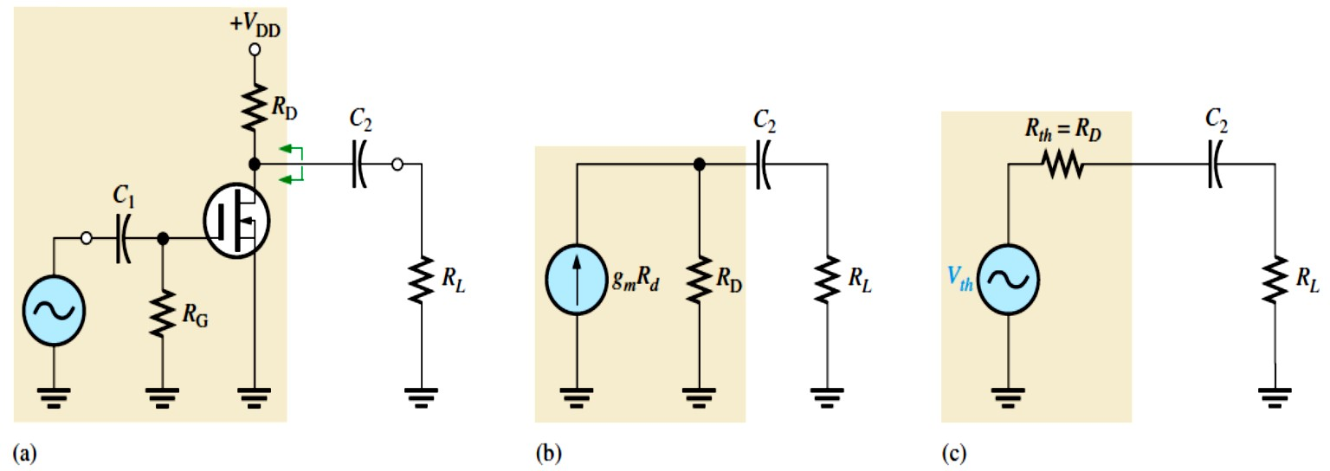
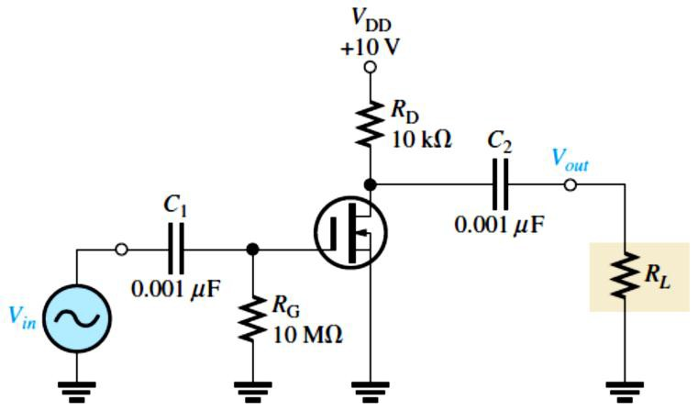
resistance looking in at the drain, as shown in Figure 10-23(a). The load resistor, 𝑅�, is also included. As in the case of the BJT, the FET is treated as a current source, and the upper end of 𝑅_{D} is effectively ac ground, as shown in Figure 10-23(b). The Thevenin equivalent of the circuit to the left of �₂ is shown in Figure 10-23(c). The lower critical frequency for this RC circuit is
�_{��(������)} = �⁄(��(𝑹� + 𝑹�)��)
Equation 10– 14
FIGURE 10-23: Development of the equivalent low-frequency output RC circuit.
The effect of the output RC circuit on the amplifier’s voltage gain below the midrange is similar to that of the input RC circuit. The circuit with the highest critical frequency dominates because it is the one that first causes the gain to roll off as the frequency drops below its midrange values. The phase angle in the low-frequency output RC circuit is
𝜽= 𝐭𝐚�^{−�}(���⁄𝑹���) = 𝐭𝐚�^{−�}(���⁄(𝑹� + 𝑹�))
Equation 10– 15
Again, at the critical frequency, the phase angle is 45° and approaches 90° as the frequency approaches zero. However, starting at the critical frequency, the phase angle decreases from 45° and becomes very small as the frequency goes higher.
EXAMPLE 10-8: Determine the lower critical frequencies for the FET amplifier in Figure 10-
24. Assume that the load is another identical amplifier with the same 𝑅_{𝑖�} and 𝑅� = 10 kΩ. The datasheet shows 𝐼_{GSS} = 100 nA @�_{GS} = −12 V.
FIGURE 10-24
Solution First, we find the lower critical
frequency for the input RC circuit.
𝑅_{𝑖�(����)} = |�_{GS}⁄𝐼_{GSS}| = |−12 V⁄100 nA|
^{𝑅}𝑖�(����) ^{= 120 MΩ}
𝑅_{𝑖�} = 𝑅_{G} ∥ 𝑅_{𝑖�(����)} = 10 MΩ ∥ 120 MΩ = 9.2 MΩ

Slide 19
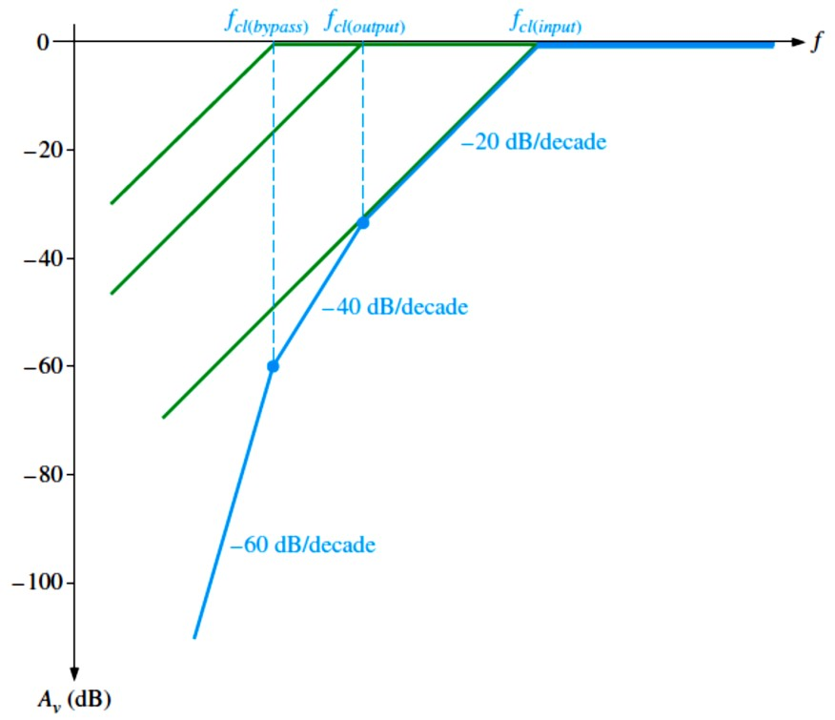
�_{��(𝑖����)} = 1⁄(2𝜋𝑅_{𝑖�}�₁) = 1⁄(2𝜋(9.2 MΩ)(0.001 𝜇F)) = 17.3 Hz
The output RC circuit has a lower critical frequency of 𝑅� = 10 kΩ
�_{��(������)} = 1⁄(2𝜋(𝑅_{D} + 𝑅�)�₂) = 1⁄(2𝜋(9.2 MΩ + 10 kΩ)(0.001 𝜇F)) ≅ 17.3 Hz
Total Low-Frequency Response of an Amplifier: Now that we have individually examined the high-pass RC circuits that affect a BJT or FET amplifier’s voltage gain at low frequencies, let’s look at the combined effect of the three RC circuits in a BJT amplifier. Each circuit has a critical frequency determined by the R and C values. The critical frequencies of the three RC circuits are not necessarily all equal. If one of the RC circuits has a critical (break) frequency higher than the other two, then it is the dominant RC circuit. The dominant circuit determines the frequency at which the overall voltage gain of the amplifier begins to drop at
−20 dB⁄decade. The other circuits each cause an additional −20 dB⁄decade roll-off below their respective critical (break) frequencies.
To get a better picture of what happens at low frequencies, refer to the Bode plot in Figure 10- 25, which shows the superimposed ideal responses for the three RC circuits (green lines) of a
BJT amplifier. In this example, each RC circuit has a different critical frequency. The input
RC circuit is dominant (highest �� ) in this case, and the bypass RC circuit has the lowest �� . The ideal overall response is shown as the blue line.
Here is what happens. As the frequency is reduced from midrange, the first “break point” occurs at the critical frequency of the input RC circuit, �_{��(𝑖����)}, and the gain begins to drop
at −20 dB⁄decade. This constant roll-off rate continues until the critical frequency of the output RC circuit, �_{��(������)}, is reached. At this break point, the output RC circuit adds another
−20 dB⁄decade to make a total roll-off of −40 dB⁄decade. This constant −40 dB⁄decade roll-off continues until the critical frequency of the bypass RC circuit, �_{��(�𝑦����)}, is reached. The bypass RC circuit adds still another −20 dB⁄decade at this break point, making the gain roll-off at −60 dB⁄decade.
FIGURE 10-25: Composite Bode plot of a BJT amplifier response for three low-
frequency RC circuits with different critical frequencies. Total response is shown by
the blue curve.

Slide 20
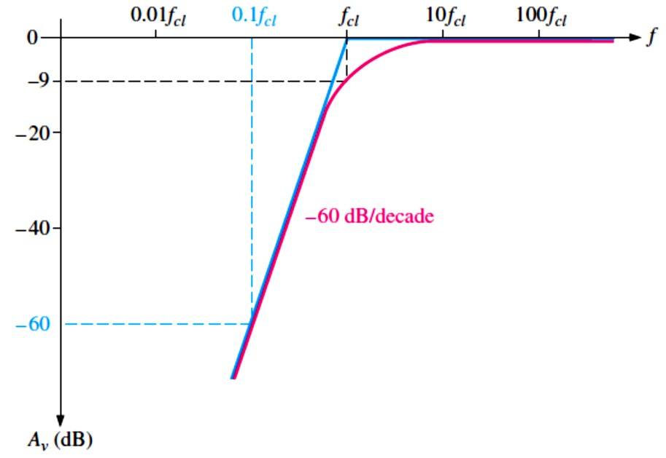

If all RC circuits have the same critical frequency, the response curve has one break point at that value of ��� , and the voltage gain rolls off at −60 dB⁄decade below that value, as shown by the ideal curve (blue) in Figure 10-26. Actually, the midrange voltage gain does not extend down to the dominant critical frequency but is really at −9 dB below the midrange voltage gain at that point (−3 dB for each RC circuit), as shown by the red curve.
FIGURE 10-26: Composite Bode plot of an amplifier response where all RC circuits
have the same ��� . (Blue is ideal; red is actual.)
EXAMPLE 10-9: For the circuit from Example 10-3 and shown in Figure 10-27, determine the midband gain in decibels and draw the Bode plot, showing each of the lower critical frequencies. Assume 𝑟´� = 9.6 Ω.
FIGURE 10-27
Solution The midband gain is
�_{�(�𝑖�)} = (𝑅_{C}𝑅�)⁄(𝑟´� + 𝑅_{E1}) = (3.9 kΩ)(5.6 kΩ)⁄(9.6 Ω + 33 Ω) = 54.0
In decibels, �_{�(�𝑖�)dB} = 20 log(54.0) = 34.3 dB
The critical frequency for the input circuit was found in Example 10-3 and is 282 Hz.
20

Slide 21
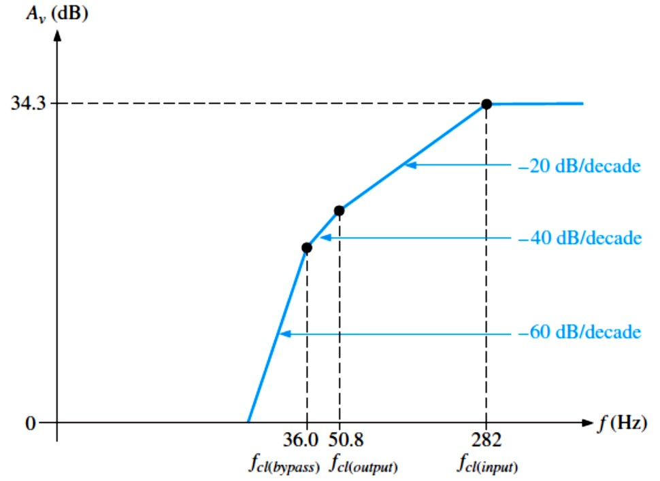
The input resistance is
𝑅_{𝑖�} = 𝑅₁ ∥ 𝑅₂ ∥ (𝛽(𝑟´� + 𝑅_{E1})) = 68 kΩ ∥ 22 kΩ ∥ (200(9.6 Ω + 33 Ω)) = 5.63 kΩ
The lower critical frequency is
�_{��(𝑖����)} = 1⁄(2𝜋𝑅_{𝑖�}�₁) = 1⁄(2𝜋(5.63 kΩ)(0.1 𝜇F)) = 282 Hz
The critical frequency for the output circuit was found in Example 10–5 and is 50.8 Hz. The resistance in the output RC circuit is 𝑅��� = 𝑅_{C} + 𝑅� = 3.9 kΩ + 5.6 kΩ = 9.5 kΩ The lower critical frequency is
�_{��(������)} = 1⁄(2𝜋(𝑅_{C} + 𝑅�)�₃) = 1⁄(2𝜋(9.5 kΩ)(0.33 𝜇F)) = 50.8 Hz
The critical frequency for the emitter bypass circuit was found in Example 10–6 and is 36.0 Hz. The resistance in the emitter bypass circuit is 𝑅_{�ℎ} = 𝑅₁ ∥ 𝑅₂ ∥ 𝑅�
^{𝑅}�ℎ
68 kΩ ∥ 22 kΩ ∥ 600 Ω
^{𝑅}𝑖�(��𝑖����) ^{= 𝑟´}� ^{+ 𝑅}E1 ⁺
The lower critical frequency is
= 9.6 Ω + 33 Ω + = 45.5 Ω
^{𝛽}��
200
���(�𝑦����) ⁼
1
=
1
= 36.0 Hz
^{2𝜋[𝑅}𝑖�(��𝑖����) ^{∥ 𝑅}E2]�2
2𝜋[45.5 Ω ∥ 1.5 kΩ](100 𝜇F)
The overall response is shown in the Bode plot of Figure 10-28. The lower critical frequency of the input circuit has the highest value and is therefore the overall or dominant critical frequency because the response first begins to roll off at this frequency.
FIGURE 10-28: Ideal Bode plot for the overall low-frequency response of the amplifier in Figure 10-27.
10.4 High-Frequency Amplifier Response
We have seen how the coupling and bypass capacitors affect the voltage gain of an amplifier at lower frequencies where the reactances of the coupling and bypass capacitors are significant.

Slide 22
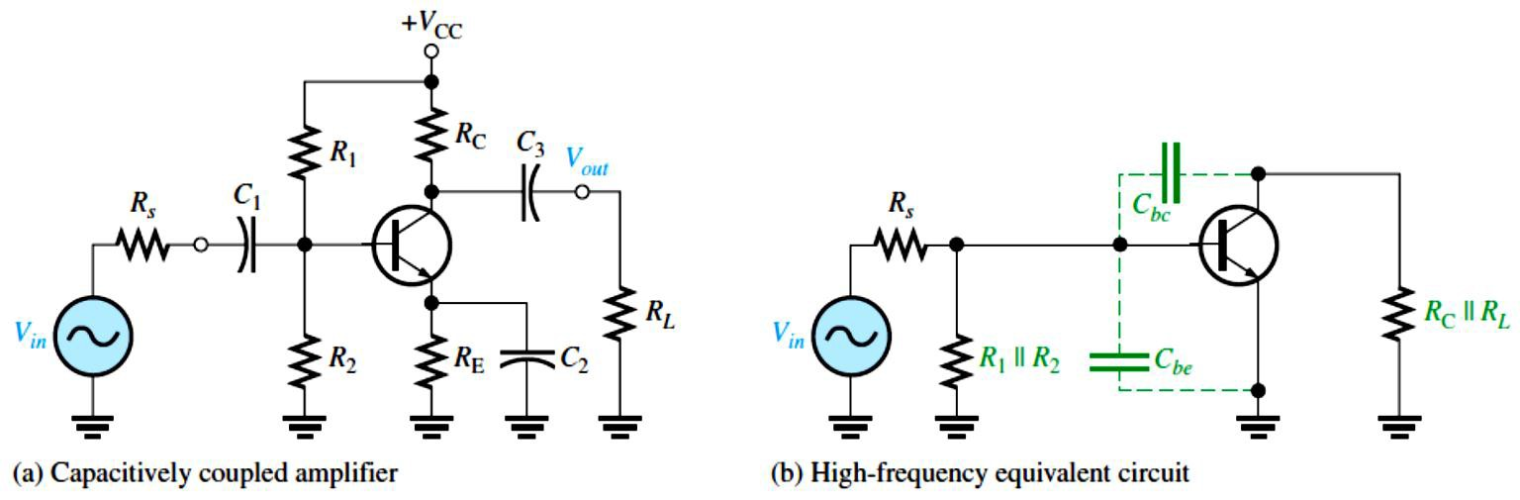
In the midrange of an amplifier, the effects of the capacitors are minimal and can be neglected.
If the frequency is increased sufficiently, a point is reached where the transistor’s internal capacitances begin to have a significant effect on the gain. The basic differences between BJTs
and FETs are the specifications of the internal capacitances and the input resistance.
BJT Amplifiers: A high-frequency ac equivalent circuit for the BJT amplifier in Figure 10- 31(a) is shown in Figure 10-31(b). The coupling and bypass capacitors are treated as effective
shorts and do not appear in the equivalent circuit. The internal capacitances, ��� and ���, which are significant only at high frequencies, do appear in the diagram. As previously mentioned. ��� is sometimes called the input capacitance �_{𝑖�} , and ��� is sometimes called the output capacitance ��� . ��� is specified on datasheets at a certain value of �_{BE}. Often, a datasheet will list �_{𝑖�} as �_{𝑖��} and ��� as ����. The o as the last letter in the subscript indicates the capacitance is measured with the base open. For example, a 2N2222A transistor has a ��� of 25 pF at �_{BE} = 0.5 V dc, 𝐼_{C} = 0, and 𝑓= 1 MHz. Also, ��� is specified at a certain value of �_{BC}. The 2N2222A has a maximum ��� of 8 pF at �_{BC} = 10 V dc.
FIGURE 10-31: Capacitively coupled amplifier and its high-frequency equivalent circuit.
Miller’s Theorem in High-Frequency Analysis By applying Miller’s theorem to the inverting amplifier in Figure 10-31(b) and using the midrange voltage gain, we have a circuit that can be analyzed for high-frequency response. Looking in from the signal source, the capacitance
��� appears in the Miller input capacitance from base to ground.
�𝑖�(�𝑖����) ^{= �}�� ^{(�}� ⁺ ¹⁾
��� simply appears as a capacitance to ac ground, as shown in Figure 10-32, in parallel with
�_{𝑖�(�𝑖����)}. Looking in at the collector, ��� appears in the Miller output capacitance from collector
to ground. As shown in Figure 10-32, the Miller output capacitance appears in parallel with 𝑅�.
����(�𝑖����) ^{= �}�� ^{((�}� ^{+ 1)⁄�}�⁾
These two Miller capacitances create a high-frequency input RC circuit and a high-frequency
output RC circuit. These two circuits differ from the low-frequency input and output circuits,

Slide 23
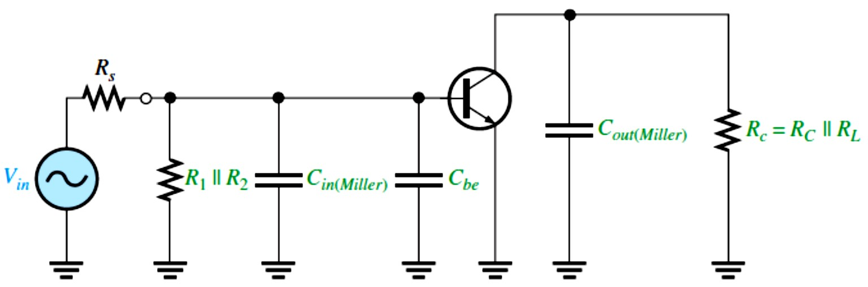
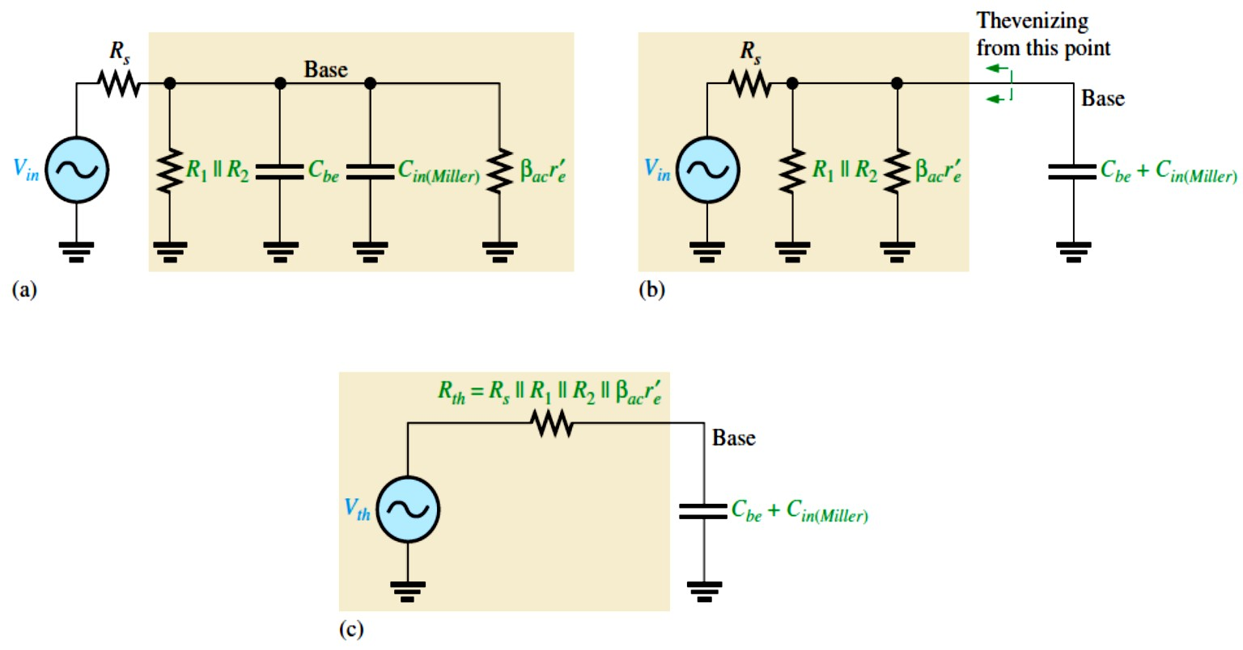
which act as high-pass filters, because the capacitances go to ground and therefore act as low- pass filters. The equivalent circuit in Figure 10-32 is an ideal model because stray capacitances that are due to circuit interconnections are neglected.
FIGURE 10-32: High-
frequency equivalent circuit after applying Miller’s theorem.
The Input RC Circuit: At high frequencies, the input circuit is as shown in Figure 10-33(a), where 𝛽�� 𝑟´� is the input resistance at the base of the transistor because the bypass capacitor effectively shorts the emitter to ground. By combining ��� and �_{𝑖�(�𝑖����)} in parallel and repositioning, we get the simplified circuit shown in Figure 10-33(b). Next, by thevenizing the circuit to the left of the capacitor, as indicated, the input RC circuit is reduced to the equivalent form shown in Figure 10-33(c).
FIGURE 10-33: Development of the equivalent high-frequency input RC circuit.
As the frequency increases, the capacitive reactance becomes smaller. This causes the signal voltage at the base to decrease, so the amplifier’s voltage gain decreases. The reason for this

Slide 24
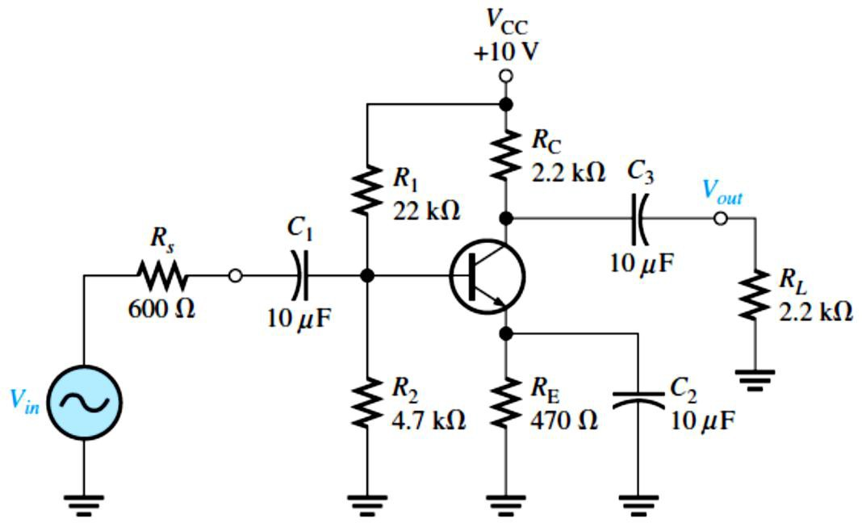
more voltage is dropped across the resistance and less across the capacitance. At the critical frequency, the gain is 3 dB less than its midrange value. The upper critical high frequency of the input circuit, �_{��(𝑖����)}, is the frequency at which the capacitive reactance is equal to the total resistance.
�𝐶_{𝑡𝑜𝑡}^{= 𝑅}𝑖�(���) ^{= 𝑅}� ^{∥ 𝑅}1 ^{∥ 𝑅}2 ^{∥ 𝛽}�� ^{𝑟}�
Therefore, 1⁄(2𝜋�_{��(𝑖����)}���� ) = 𝑅� ∥ 𝑅₁ ∥ 𝑅₂ ∥ 𝛽�� 𝑟´�, and
´
���(𝑖����) ⁼ _{2𝜋(𝑅}
1
Equation 10– 16
∥ 𝑅∥ 𝑅∥ 𝛽𝑟´ )�
� 1 2 �� � ���
where 𝑅� is the resistance of the signal source and ���� = ��� + �_{𝑖�(�𝑖����)}. As the frequency
goes above
���(𝑖����),
the input RC circuit causes the gain to roll off at a rate of
−20 dB⁄decade just as with the low-frequency response.
EXAMPLE 10-11: Derive the equivalent high-frequency input RC circuit for the BJT amplifier in Figure 10-34. Use this to determine the upper critical frequency due to the input circuit. The transistor’s datasheet provides the following: 𝛽�� = 125, ��� = 20 pF, and ��� = 2.4 pF.
FIGURE 10-34
Solution First, we find 𝑟´� as follows:
�_{B} = (𝑅₂⁄(𝑅₁ + 𝑅₂))�_{CC}
�_{B} = (4.7 kΩ⁄(22 kΩ + 4.7 kΩ))10 V
�_{B} = 1.76 V
�_{BE} = �_{B} − �_{E}
�_{E} = �_{B} − �_{BE}
�_{E} = 1.76 V − 0.7 V = 1.06 V
�_{E} 1.06 V
𝐼_{E} = _{𝑅}= _{470 Ω} = 2.26 mA
E
𝑟´� = 25 mV⁄𝐼_{E} = 25 mV⁄2.26 mA = 11.1 Ω
The total resistance of the input circuit is
𝑅_{𝑖�(���)} = 𝑅� ∥ 𝑅₁ ∥ 𝑅₂ ∥ 𝛽�� 𝑟´� = 600 Ω ∥ 22 kΩ ∥ 4.7 kΩ ∥ 125(11.1 Ω) = 378 Ω Next, in order to determine the capacitance, we must calculate the midrange gain of the amplifier so that we can apply Miller’s theorem.
�_{�(�𝑖�)} = 𝑅�⁄𝑟´� = (𝑅_{C} ∥ 𝑅�)⁄𝑟´� = (2.2 kΩ ∥ 2.2 kΩ)⁄11.1 Ω = 1.1kΩ⁄11.1 Ω = 99
Apply Miller’s theorem. �_{𝑖�(�𝑖����)} = ��� (�_{�(�𝑖�)} + 1) = (2.4 pF)(99 + 1) = 240 pF
The total input capacitance is �_{𝑖�(�𝑖����)} in parallel with ���.
�𝑖�(���) ^{= �}𝑖�(�𝑖����) ^{+ �}��
= 240 pF + 20 pF = 260 pF

Slide 25
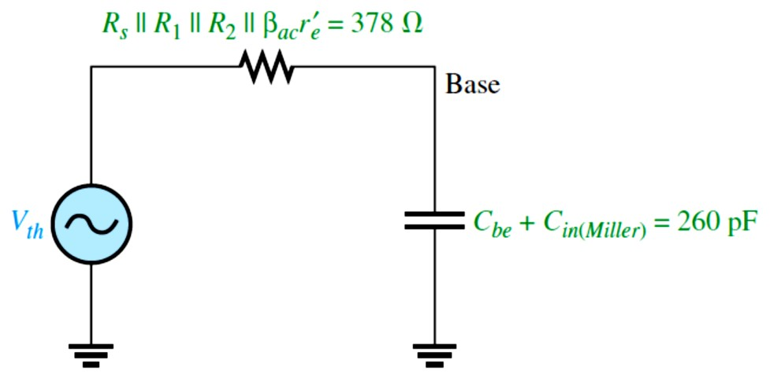
The resulting high-frequency input RC circuit is shown in Figure 10-35. The upper critical frequency is
�_{��(𝑖����)} = 1⁄(2𝜋(𝑅_{𝑖�(���)})(�_{𝑖�(���)})) = 1⁄(2𝜋(378 Ω)(260 pF)) = 1.62 MHz
FIGURE 10-35: High-frequency equivalent input RC circuit for the amplifier in Figure 10-34.
Phase Shift of the Input RC Circuit: Because the output voltage of a high-frequency input RC circuit is across the capacitor, the output of the circuit lags the input. The phase angle is expressed as
𝜽= 𝐭𝐚�^{−�} (𝑹_{��(���)}⁄�� ) = 𝐭𝐚�^{−�} ((𝑹� ∥ 𝑹� ∥ 𝑹� ∥ 𝜷���´�)⁄��
) Equation 10– 17
(���) (���)
At the critical frequency, the phase angle is 45° with the signal voltage at the base of the transistor lagging the input signal. As the frequency increases above �� , the phase angle increases above 45° and approaches 90° when the frequency is sufficiently high.
The Output RC Circuit: The high-frequency output RC circuit is formed by the Miller output capacitance and the resistance looking in at the collector, as shown in Figure 10-36(a). In determining the output resistance, the transistor is treated as a current source (open) and one end of 𝑅_{C} is effectively ac ground, as shown in Figure 10-36(b). By rearranging the position of the capacitance in the diagram and thevenizing the circuit to the left, as shown in Figure 10-36(c), we get the equivalent circuit in Figure 10-36(d). The equivalent output RC circuit consists of a resistance equal to the parallel combination of 𝑅_{C} and 𝑅� in series with a capacitance that is determined by the following Miller formula:
����(�𝑖����) ^{= �}�� ^{((�}� ^{+ 1)⁄�}�⁾
If the voltage gain is at least 10, this formula can be approximated as
����(�𝑖����) ≅ ���
The upper critical frequency for the output circuit is determined with the following equation, where 𝑅� = 𝑅_{C} ∥ 𝑅�.
���(������) ^{= �⁄(��𝑹}�����(������)⁾
Equation 10– 18

Slide 26
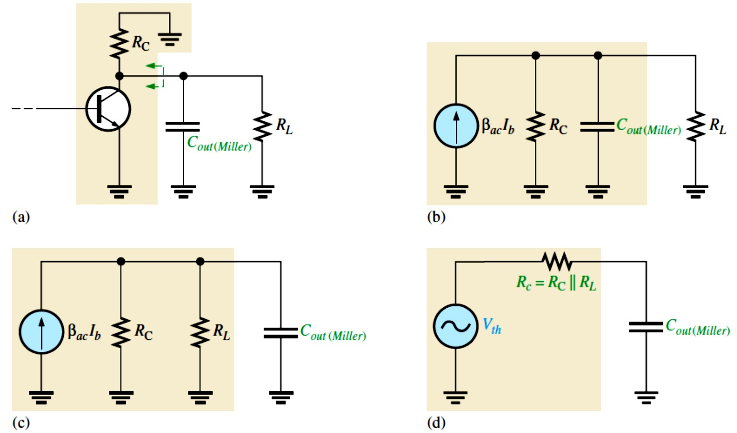
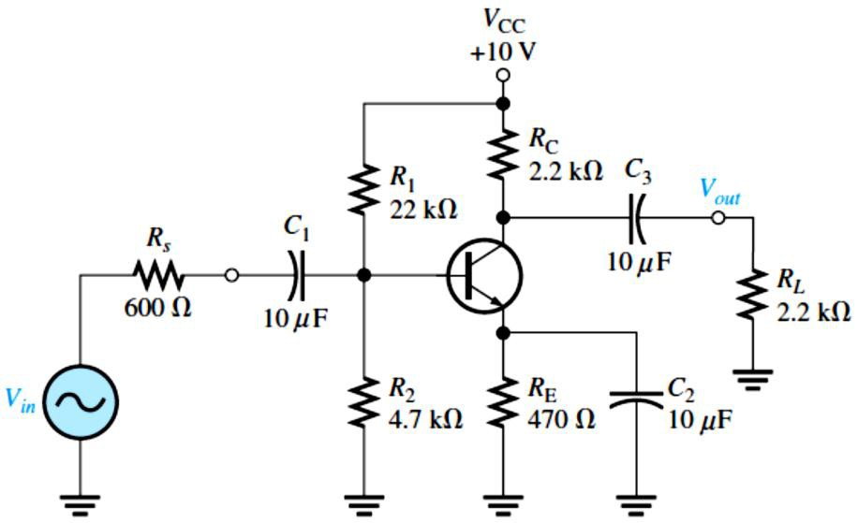
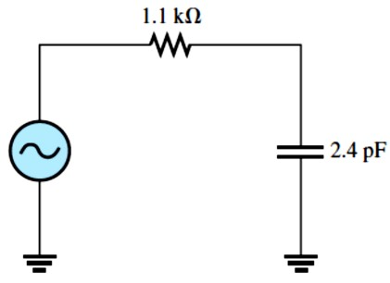
FIGURE 10-36: Development of the equivalent high-frequency output RC circuit.
Just as in the input RC circuit, the output RC circuit reduces the gain by 3 dB at the critical frequency. When the frequency goes above the critical value, the gain drops at a
−20 dB/decade rate. The phase angle introduced by the output RC circuit is
𝜽= 𝐭𝐚�^{−�} (𝑹�⁄��
���(������)
) Equation 10– 19
EXAMPLE 10-12: Determine the upper critical frequency of the amplifier in Example 10–11 shown in Figure 10-37 due to its output RC circuit.
FIGURE 10-37
Solution We calculate the
Miller output capacitance.
����(�𝑖����) ^{= �}�� ^{((�}� ^{+ 1)⁄�}�⁾
�_{���(�𝑖����)} = (2.4 pF)((99 + 1)⁄99)
����(�𝑖����) ^{≅ 2.4 pF}
The equivalent resistance is
𝑅� = 𝑅_{C} ∥ 𝑅� = 2.2 kΩ ∥ 2.2 kΩ
𝑅� = 1.1 kΩ
The equivalent output RC circuit is shown in Figure 10-38. We determine the upper critical frequency as follows (�_{���(�𝑖����)} ≅ ���):
���(������) ^{= 1⁄(2𝜋𝑅}� ����(�𝑖����)⁾
FIGURE 10-38
���(������)
= 1⁄(2𝜋(1.1 kΩ)(2.4 pF)) = 60.3 MHz

Slide 27
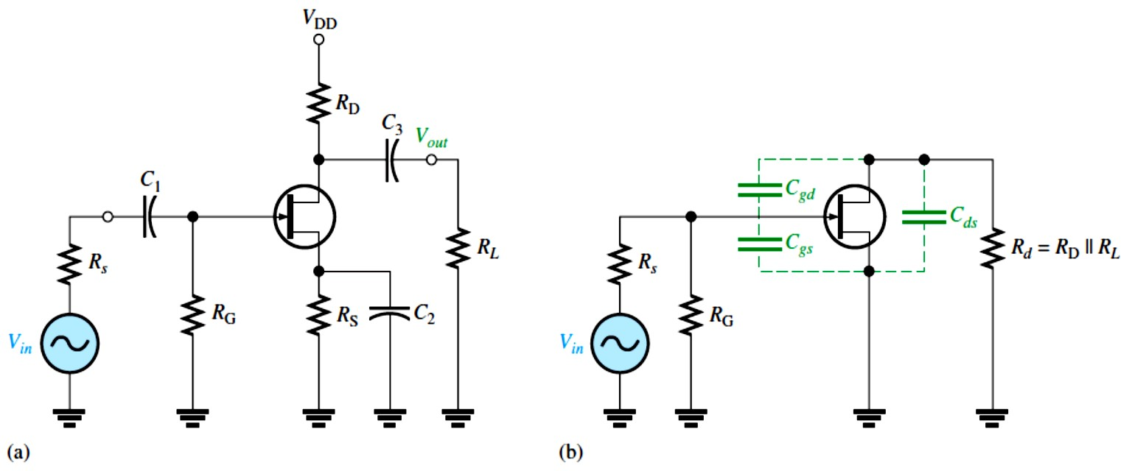
FET Amplifiers: The approach to the high-frequency analysis of a FET amplifier is similar to that of a BJT amplifier. The basic differences are the specifications of the internal FET capacitances and the determination of the input resistance.
Figure 10-39(a) shows a JFET common-source amplifier that will be used to illustrate high- frequency analysis. A high-frequency equivalent circuit for the amplifier is shown in Figure 10-39(b). The coupling and bypass capacitors are assumed to have negligible reactances and
are considered to be shorts. The internal capacitances �_{g�} and �_{g�} appear in the equivalent circuit because their reactances are significant at high frequencies.
FIGURE 10-39: Example of a JFET amplifier and its high-frequency equivalent circuit.
Values of �_{𝐠�}, �_{𝐠�}, and ���: FET datasheets do not normally provide values for �_{g�}, �_{g�} , or
���. Instead, three other values are usually specified because they are easier to measure. These are �_{𝑖��}, the input capacitance; ����, the reverse transfer capacitance; and ����, the output capacitance. Because of the manufacturer’s method of measurement, the following relationships allow us to determine the capacitor values needed for analysis.
�𝐠� ^{= �}���
�𝐠� ^{= �}��� ^{− �}���
��� ^{= �}��� ^{− �}���
Equation 10– 20
Equation 10– 21
Equation 10– 22
���� is not specified as often as the other values on datasheets. Sometimes, it is designated as
�_{�(���)}, the drain-to-substrate capacitance. In cases where a value is not available, we must
either assume a value or neglect ���.
EXAMPLE 10-13: The datasheet for a 2N3823 JFET gives �_{𝑖��} = 6 pF and ���� = 2 pF. Determine �_{g�} and �_{g�}.
Solution
�_{g�} = ���� = 2 pF, �_{g�} = �_{𝑖��} − ���� = 6 pF − 2 pF = 4 pF

Slide 28
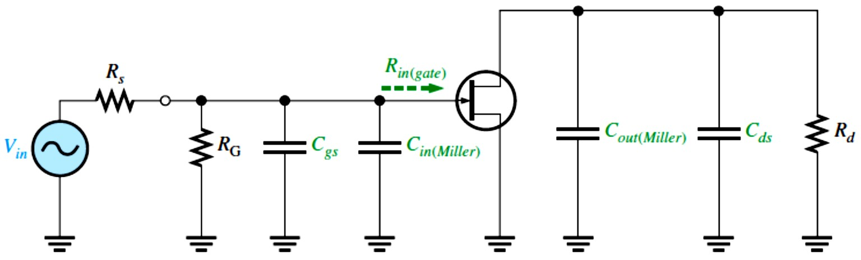
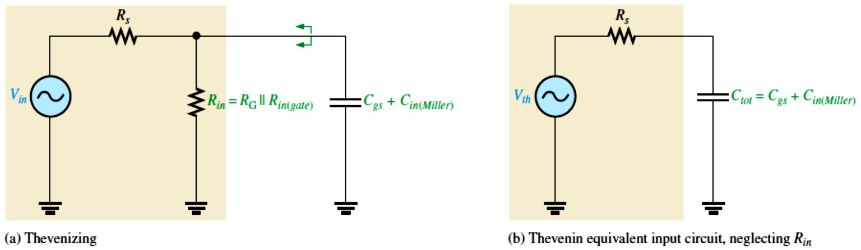
Using Miller’s Theorem: Miller’s theorem is applied the same way in FET inverting amplifier high-frequency analysis as was done in BJT amplifiers. Looking in from the signal source in Figure 10-39(b), �_{g�} effectively appears in the Miller input capacitance, which was given in Equation 10-1, as follows: �_{𝑖�(�𝑖����)} = �_{g�} (�� + 1)
�_{g�} simply appears as a capacitance to ac ground in parallel with �_{𝑖�(�𝑖����)}, as shown in Figure 10 -40. Looking in at the drain, �_{g�} effectively appears in the Miller output capacitance (from Equation 10-2) from drain to ground in parallel with 𝑅�, as shown in Figure 10-40.
����(�𝑖����) ^{= �}g� ^{((�}� ^{+ 1)⁄�}�⁾
These two Miller capacitances contribute to a high-frequency input RC circuit and a high-
frequency output RC circuit. Both are low-pass filters, which produce phase lag.
FIGURE 10-40:
High-frequency equivalent circuit after applying Miller’s theorem.
The Input RC Circuit: The high-frequency input circuit forms a low-pass type of filter and is shown in Figure 10-41(a). Because both 𝑅_{G} and the input resistance at the gate of FETs are extremely high, the controlling resistance for the input circuit is the resistance of the input source as long as 𝑅� ≪ 𝑅_{𝑖�}. This is because 𝑅� appears in parallel with 𝑅_{𝑖�} when Thevenin’s theorem is applied. The simplified input RC circuit appears in Figure 10-41(b). The upper critical frequency for the input circuit is
���(�����) ^{= �⁄(��𝑹}�����⁾
Equation 10– 23
where ���� = �_{g�} + �_{𝑖�(�𝑖����)}. The input RC circuit produces a phase angle of
𝜽= 𝐭𝐚�^{−�}(𝑹�⁄��
���
) Equation 10– 24
The effect of the input RC circuit is to reduce the midrange gain of the amplifier by 3 dB at the critical frequency and to cause the gain to decrease at −20 dB/decade above �� .
FIGURE 10-41:
Input RC
circuit.

Slide 29
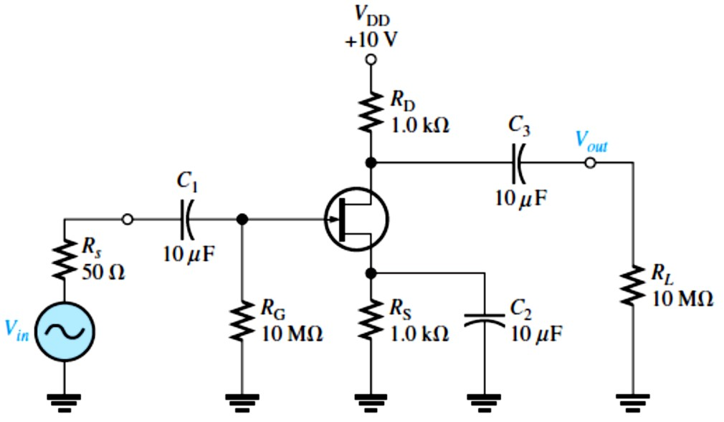
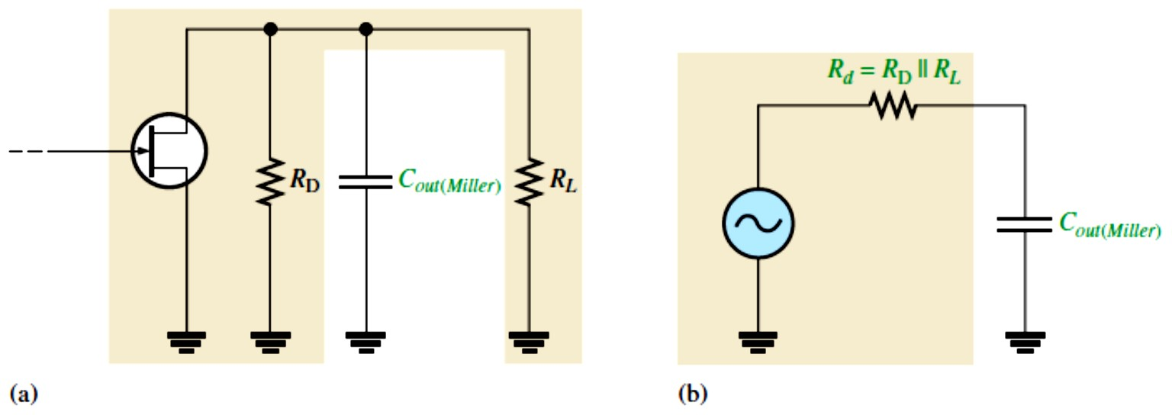
EXAMPLE 10-14: Find the upper critical frequency of the input RC circuit for the FET amplifier in Figure 10-42. �_{𝑖��} = 8 pF, ���� = 3 pF, and g� = 6500 μS.
FIGURE 10-42
Solution We determine �_{g�} and �_{g�}.
�_{g�} = ���� = 3 pF
�_{g�} = �_{𝑖��} − ���� = 8 pF − 3 pF = 5 pF
Determine the upper critical frequency for the input RC circuit as follows:
�� = g�𝑅� = g�(𝑅_{D} ∥ 𝑅�)
�� ≅ (6500 μS)(1 kΩ ∥ 10 MΩ)
�� ≅ (6500 μS)(1 kΩ) = 6.5
�_{𝑖�(�𝑖����)} = �_{g�} (�� + 1) = (3 pF)(6.5 + 1) = 22.5 pF
The total input capacitance is �_{𝑖�(���)} = �_{g�} + �_{𝑖�(�𝑖����)} = 5 pF + 22.5 pF = 27.5 pF
The upper critical frequency is
�_{��(𝑖����)} = 1⁄(2𝜋𝑅��_{𝑖�(���)}) = 1⁄(2𝜋(50 Ω)(27.5 pF)) = 116 MHz
The Output RC Circuit: The high-frequency output RC circuit is formed by the Miller output capacitance and the output resistance looking in at the drain, as shown in Figure 10-43(a). As in the case of the BJT, the FET is treated as a current source. When we apply Thevenin’s theorem, we get an equivalent output RC circuit consisting of 𝑅_{D} in parallel with 𝑅� and an equivalent output capacitance.
����(�𝑖����) ^{= �}g� ^{((�}� ^{+ 1)⁄�}�⁾
This equivalent output circuit is shown in Figure 10-43(b). The critical frequency of the
output RC lag circuit is
���(�����) ^{= �⁄(��𝑹}�����(������)⁾
The output circuit produces a phase shift of
Equation 10– 25
𝜽= 𝐭𝐚�^{−�} (𝑹�⁄��
���(������)
)
Equation 10– 26
FIGURE 10-43:
Output RC circuit.

Slide 30
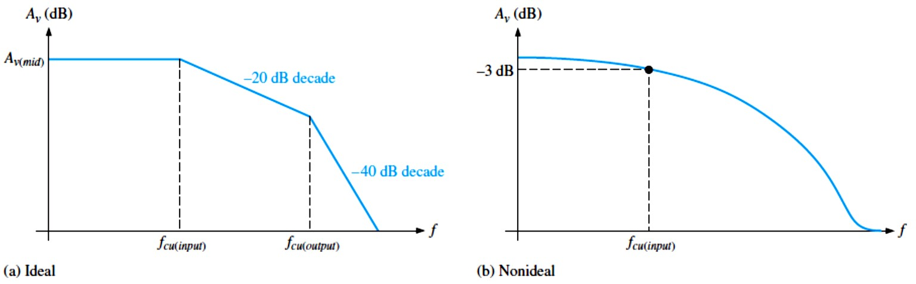
EXAMPLE 10-15: Determine the upper critical frequency of the output RC circuit for the FET amplifier in Figure 10-42. What is the phase shift introduced by this circuit at the critical frequency? Which RC circuit is dominant, that is, which one has the lower value of upper critical frequency?
Solution Since 𝑅� is very large compared to 𝑅_{D}, it can be neglected, and the equivalent output resistance is 𝑅� = 𝑅_{D} ∥ 𝑅� ≅ 𝑅_{D} = 1 kΩ
The equivalent output capacitance is
�_{���(�𝑖����)} = �_{g�} ((�� + 1)⁄��) = (3 pF)((6.5 + 1)⁄6.5) = 3.46 pF
Therefore, the upper critical frequency is
�_{��(�����)} = 1⁄(2𝜋𝑅� �_{���(�𝑖����)}) = 1⁄(2𝜋(1 kΩ)(3.46 pF)) = 46 MHz
Although it has been neglected, any stray wiring capacitance could significantly affect the frequency response because �_{���(�𝑖����)} is very small. The phase angle 45° is always at �� for an RC circuit and the output lags. In Example 10-14, the upper critical frequency of the input RC circuit was found to be 116 MHz. Therefore, the upper critical frequency for the output circuit is dominant because it is the lower of the two.
Total High-Frequency Response of an Amplifier: As we have seen, the two RC circuits created by the internal transistor capacitances influence the high-frequency response of both BJT and FET amplifiers. As the frequency increases and reaches the high end of its midrange values, one of the RC circuits will cause the amplifier’s gain to begin dropping off. The frequency at which this occurs is the dominant upper critical frequency; it is the lower of the two upper critical high frequencies. An ideal high-frequency Bode plot is shown in Figure 10- 44(a). It shows the first break point at �_{��(𝑖����)} where the voltage gain begins to roll off at
−20 dB/decade. At �_{��(�����)}, the gain begins dropping at −40 dB/decade because each RC circuit is providing a −20 dB/decade roll-off. Figure 10-44(b) shows a nonideal Bode plot where the voltage gain is actually −3 dB/decade below midrange at �_{��(𝑖����)}. Other possibilities are that the output RC circuit is dominant or that both circuits have the same critical frequency.
FIGURE 10-44: High-frequency Bode plots.
30

Slide 31
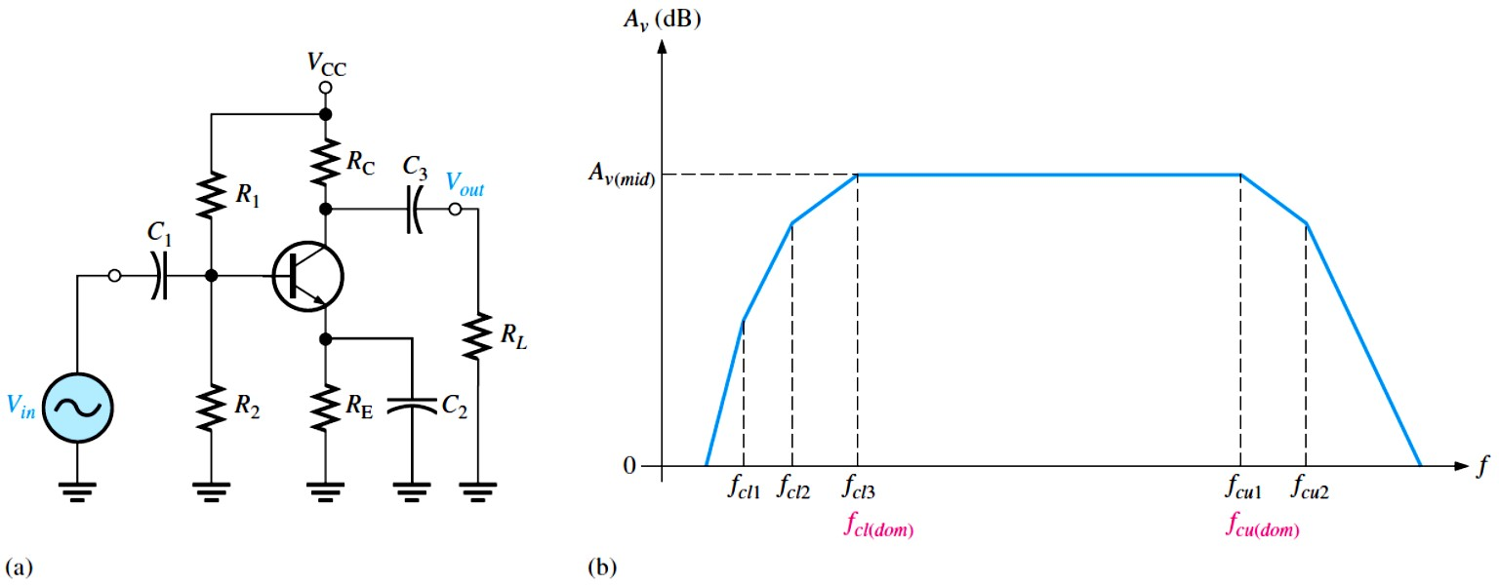
10.5 Total Amplifier Frequency Response
In the previous sections, we learned how each RC circuit in an amplifier affects the frequency response. In this section, we will bring these concepts together and examine the total response of typical amplifiers and the specifications relating to their performance.
Figure 10-45(b) shows a generalized ideal response curve (Bode plot) for the BJT amplifier shown in Figure 10-45(a). As previously discussed, the three break points at the lower critical
frequencies (�_{��1}, �_{��2}, and �_{��3}) are produced by the three low-frequency RC circuits formed by the coupling and bypass capacitors. The break points at the upper critical frequencies, �_{��1}
and �_{��2}, are produced by the two high-frequency RC circuits formed by the transistor’s internal capacitances.
FIGURE 10-45: A BJT amplifier and its generalized ideal response curve (Bode plot).
Of particular interest are the two dominant critical frequencies, �_{��3} and �_{��1}, in Figure 10– 45(b). These two frequencies are where the voltage gain of the amplifier is 3 dB below its midrange value. These dominant frequencies are designated �_{��(���)} and �_{��(���)}.
The upper and lower dominant critical frequencies are sometimes called the half-power frequencies. This term is derived from the fact that the output power of an amplifier at its critical frequencies is one-half of its midrange power, as previously mentioned. This can be shown as follows, starting with the fact that the output voltage is 0.707 of its midrange value at the dominant critical frequencies.
����(�_{𝑐}) ^{= 0.707�}���(�𝑖�)
²⁄𝑅
= (0.707�
2
) ⁄𝑅= 0.5�
²⁄𝑅
= 0.5 𝑃
^{𝑃}���(�_{𝑐}) ^{= �}���(�_{𝑐}) ���
���(�𝑖�) ��� ���(�𝑖�) ��� ���(�𝑖�)
Bandwidth: An amplifier normally operates with signal frequencies between �_{��(���)} and
�_{��(���)}. As we know, when the input signal frequency is at �_{��(���)} or �_{��(���)}, the output signal voltage level is 70.7% of its midrange value or −3 dB. If the signal frequency drops

Slide 32
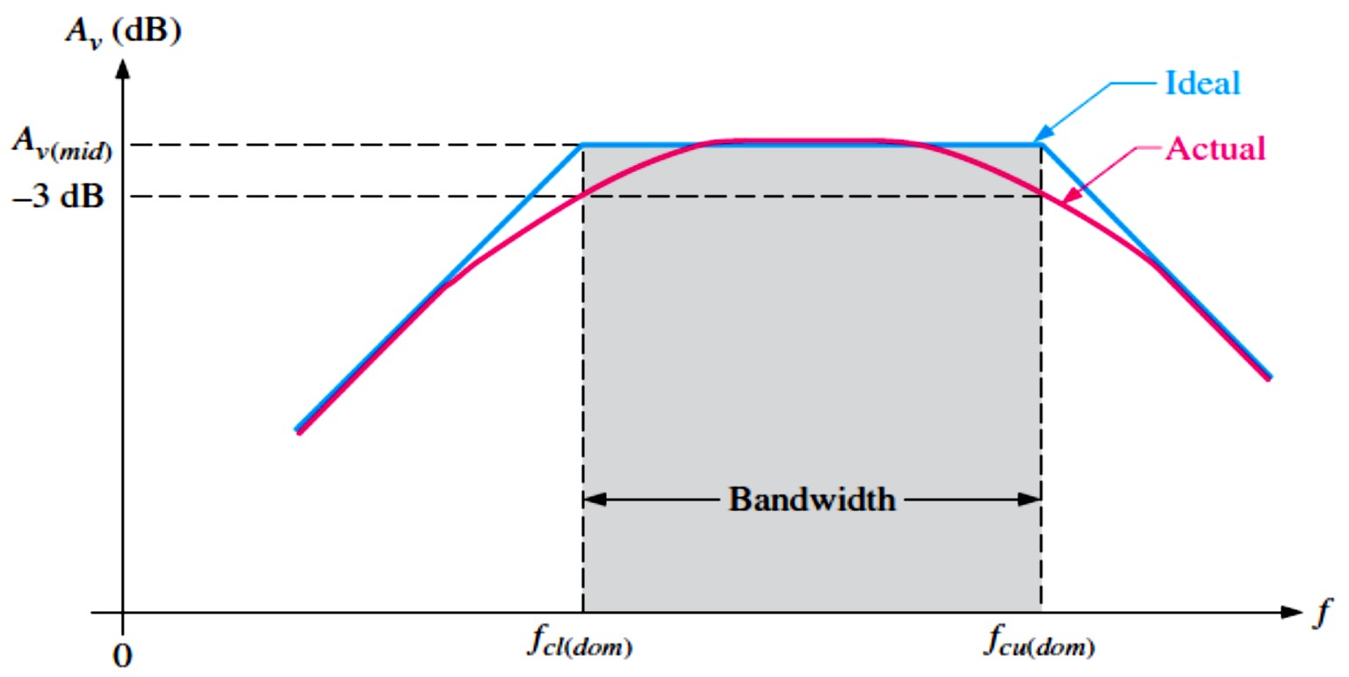
below �_{��(���)}, the gain and thus the output signal level drops at 20 dB/decade until the next critical frequency is reached. The same occurs when the signal frequency goes above �_{��(���)}.
The range (band) of frequencies lying between �_{��(���)}
^{and �}��(���)
is defined as the
bandwidth of the amplifier, as illustrated in Figure 10-46. Only the dominant critical frequencies appear in the response curve because they determine the bandwidth. Also, sometimes the other critical frequencies are far enough away from the dominant frequencies that they play no significant role in the total amplifier response and can be neglected. The amplifier’s bandwidth is expressed in units of hertz as
^{�� = �}��(���) ^{− �}��(���)
Equation 10– 27
FIGURE 10-46: Response curve illustrating the bandwidth of an amplifier.
Ideally, all signal frequencies lying in an amplifier’s bandwidth are amplified equally. For example, if a 10 mV rms signal is applied to an amplifier with a voltage gain of 20, it is amplified to 200 mV rms for all frequencies in the bandwidth. Actually, the gain is down 3
^{dB at �}��(���) ^{and �}��(���).
EXAMPLE 10-16: What is the bandwidth of an amplifier having an �_{��(���)} of 200 Hz and an
�_{��(���)} of 2 kHz?
Solution
�� = �_{��(���)} − �_{��(���)} = 2 kHz − 200 Hz = 1800 Hz
Notice that bandwidth has the unit of hertz.
Gain-Bandwidth Product: One characteristic of amplifiers is that the product of the voltage gain and the bandwidth is always constant when the roll-off is −20 dB/decade. This characteristic is called the gain-bandwidth product. Let’s assume that the dominant lower critical frequency of a particular amplifier is much less than the dominant upper critical
^{frequency. �}��(���) ≪ ���(���)

Slide 33
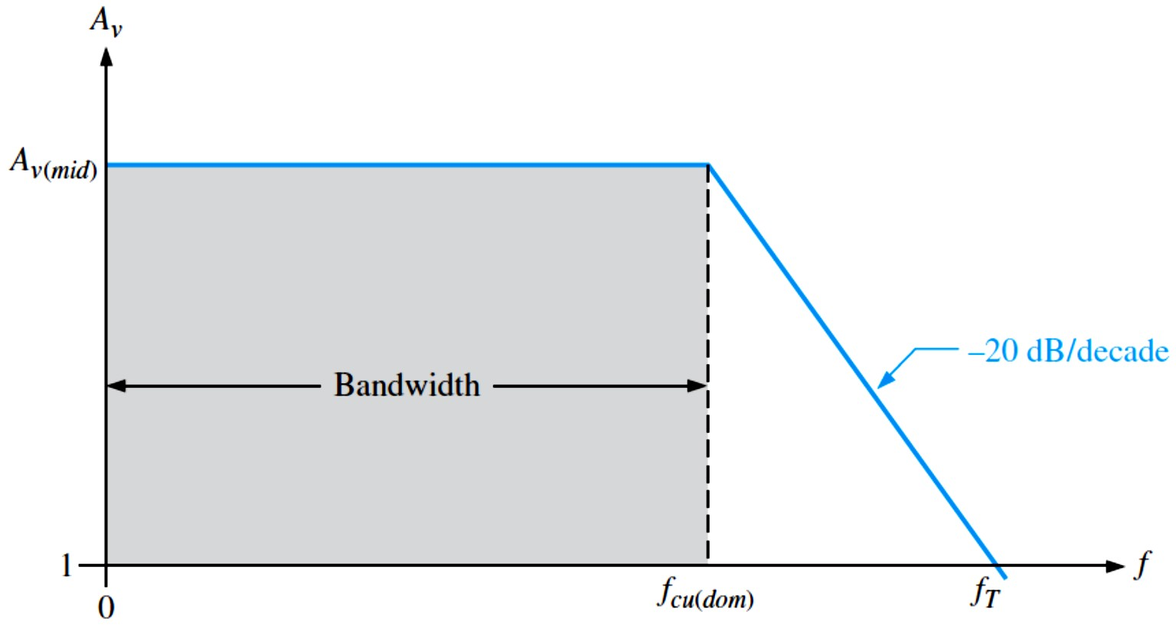
The bandwidth can then be approximated as �� = �_{��(���)} − �_{��(���)} ≅ ���
Unity-Gain Frequency: The simplified Bode plot for this condition is shown in Figure 10-47.
���(���)
is neglected because it is so much smaller than �_{��(���)}, and the bandwidth
approximately equals �_{��(���)}. Beginning at �_{��(���)}, the gain rolls off until unity gain (0 dB) is reached. The frequency at which the amplifier’s gain is 1 is called the unity-gain frequency, �_{𝑇}. The significance of �_{𝑇}is that it always equals the midrange voltage gain times the bandwidth and is constant for a given transistor.
�𝑻^{= �}�(���) ��
Equation 10– 28
For the case shown in Figure 10-47, �_{𝑇}= �_{�(�𝑖�)} �_{��(���)}. For example, if a transistor datasheet specifies �_{𝑇}= 100 MHz, this means that the transistor is capable of producing a voltage gain of 1 up to 100 MHz, or a gain of 100 up to 1 MHz, or any combination of gain and bandwidth that produces a product of 100 MHz.
FIGURE 10-47: Simplified response curve where �_{��(���)} is negligible (assumed to be zero) compared to
���(���).
EXAMPLE 10-17: A certain transistor has an �_{𝑇}of 175 MHz. When this transistor is used in an amplifier with a midrange voltage gain of 50, what bandwidth can be achieved ideally?
Solution �_{𝑇}= �_{�(�𝑖�)} �� , �� = �_{𝑇}⁄�_{�(�𝑖�)} = 175 MHz⁄50 = 3.5 MHz
10.6 Frequency Response of Multistage Amplifiers
To this point, we have seen how the voltage gain of a single-stage amplifier changes over frequency. When two or more stages are cascaded to form a multistage amplifier, the overall frequency response is determined by the frequency response of each stage depending on the relationships of the critical frequencies.

Slide 34
When amplifier stages are cascaded to form a multistage amplifier, the dominant frequency response is determined by the responses of the individual stages. There are two cases to consider:
  Each stage has a different dominant lower critical frequency and a different dominant upper critical frequency.
  Each stage has the same dominant lower critical frequency and the same dominant upper critical frequency.
Different Critical Frequencies: Ideally, when the dominant lower critical frequency,
�_{��(���)}, of each amplifier stage is different from the other stages, the overall dominant lower
critical frequency, �_{��(���)}´, equals the dominant critical frequency of the stage with the highest �_{��(���)}.
Ideally, when the dominant upper critical frequency, �_{��(���)}, of each amplifier stage is
different from the other stages, the overall dominant upper critical frequency, �_{��(���)}´,
equals the dominant critical frequency of the stage with the lowest �_{��(���)}.
In practice, the critical frequencies interact, so these calculated values should be considered approximations that are useful for troubleshooting or estimating the response. When more accuracy is required, a computer simulation is the best solution.
Overall Bandwidth The bandwidth of a multistage amplifier is the difference between the overall dominant lower critical frequency and the overall dominant upper critical frequency.
^{�� = �}��(���)^{´ − �}��(���)´
EXAMPLE 10-18: In a certain 2-stage amplifier, one stage has a dominant lower critical frequency of 850 Hz and a dominant upper critical frequency of 100 kHz. The other has a dominant lower critical frequency of 1 kHz and a dominant upper critical frequency of 230 kHz. Determine the overall bandwidth of the 2-stage amplifier.
Solution
�_{��(���)}´ = The dominant lower critical frequency of the stage with the highest �_{��(���)}
���(���)^{´ = 1 kHz}
�_{��(���)}´ = The dominant upper critical frequency of the stage with the lowest �_{��(���)}
�_{��(���)}´ = 100 kHz, �� = �_{��(���)}´ − �_{��(���)}´ = 100 kHz − 1 kHz = 99 kHz
Equal Critical Frequencies: When each amplifier stage in a multistage arrangement has equal dominant critical frequencies, we may think that the overall dominant critical frequency is equal to the critical frequency of each stage. This is not the case, however.
When the dominant lower critical frequencies of each stage in a multistage amplifier are all the same, the overall dominant lower critical frequency is increased by a factor of

Slide 35
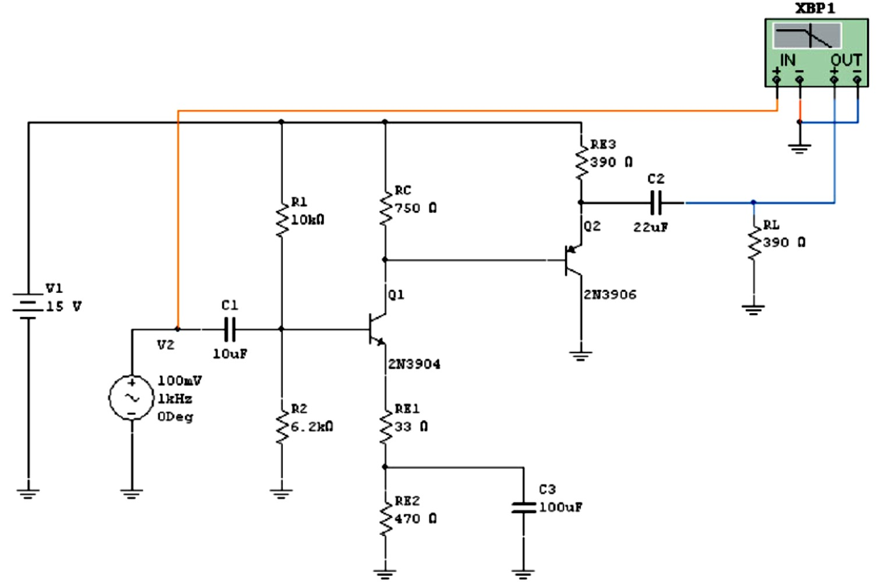
1⁄√2^{1⁄�} − 1 as shown by the following formula (n is the number of stages in the multistage amplifier):
���(���)^{´ = �}��(���)^{⁄(�⁄√��⁄� − �)}
Equation 10– 29
When the dominant upper critical frequencies of each stage are all the same, the overall dominant upper critical frequency is reduced by a factor of √2^{1⁄�} − 1.
���(���)^{´ = �}��(���) ^{√��⁄� − �}
Equation 10– 30
EXAMPLE 10-19: Both stages in a 2-stage amplifier have a dominant lower critical frequency of 500 Hz and a dominant upper critical frequency of 80 kHz. Determine the overall bandwidth. Solution
�_{��(���)}´ = �_{��(���)}⁄(1⁄√2^{1⁄�} − 1) = 500 Hz⁄(1⁄√2^{1⁄2} − 1) = 500 Hz⁄0.644 = 776 Hz
�_{��(���)}´ = �_{��(���)} √2^{1⁄�} − 1 = (80 kHz)√2^{1⁄2} − 1 = (80 kHz)(0.644) = 51.5 kHz
�� = �_{��(���)}´ − �_{��(���)}´ = 51.5 kHz − 776 Hz = 50.7 kHz
Computer Simulation for Multistage Amplifiers: With multistage amplifiers, the detailed calculation of the frequency response is greatly simplified by computer simulation. There are several interactions within each stage and other interactions between the stages that affect the overall response. When we need more accuracy, a computer simulation is used. This is particularly useful in design work because we can change a component and see the effect immediately on the frequency response. The following example illustrates the application of computer analysis to a multistage amplifier.
EXAMPLE 10-20: A dc coupled two-stage amplifier is simulated with Multisim in Figure 10- 48 to determine the overall frequency response.
FIGURE 10-48

Slide 36
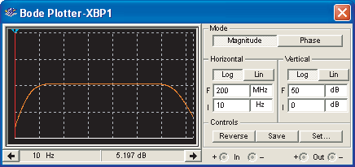
Solution The circuit was constructed in Multisim by dragging the parts needed onto the simulated workbench and connecting them. Connect the Bode plotter and adjust it to show the complete response curve with upper and lower critical frequencies. Figure 10-49 shows the display. When the cursor is moved to the lower critical frequency (3 dB below midrange), a reading of approximately 56 Hz is observed. When the cursor is moved to the upper critical frequency, a reading of approximately 34 MHz is observed.
FIGURE 10-49
10.7 Frequency Response Measurements
Two basic methods are used to measure the frequency response of an amplifier. The methods apply to both BJT and FET amplifiers although a BJT amplifier is used as an example. We will concentrate on determining the two dominant critical frequencies. From these values, we can get the bandwidth.
Frequency/Amplitude Measurement: Figure 10-50(a) shows the test setup for an amplifier circuit board. The schematic for the circuit board is also shown. The amplifier is driven by a
sinusoidal voltage source with a dual-channel oscilloscope connected to the input and to the
output. The input frequency is set to a midrange value, and its amplitude is adjusted to establish an output signal reference level, as shown in Figure 10-50(b). This output voltage reference
level for midrange should be set at a convenient value within the linear operation of the
amplifier: for example, 100 mV, 1 V, 10 V, and so on. In this case, set the output signal to a peak value of 1 V.
Next, the frequency of the input voltage is decreased until the peak value of the output drops to 0.707 V. The amplitude of the input voltage must be kept constant as the frequency is reduced. Readjustment may be necessary because of changes in loading of the voltage source with frequency. When the output is 0.707 V, the frequency is measured, and we have the value for ��� as indicated in Figure 10-50(c).
Next, the input frequency is increased back up through midrange and beyond until the peak value of the output voltage again drops to 0.707 V. Again, the amplitude of the input must be kept constant as the frequency is increased. When the output is 0.707 V, the frequency is measured and we have the value for ��� as indicated in Figure 10 –50(d). From these two
frequency measurements, we can find the bandwidth by the formula �� = ��� − ���

Slide 37
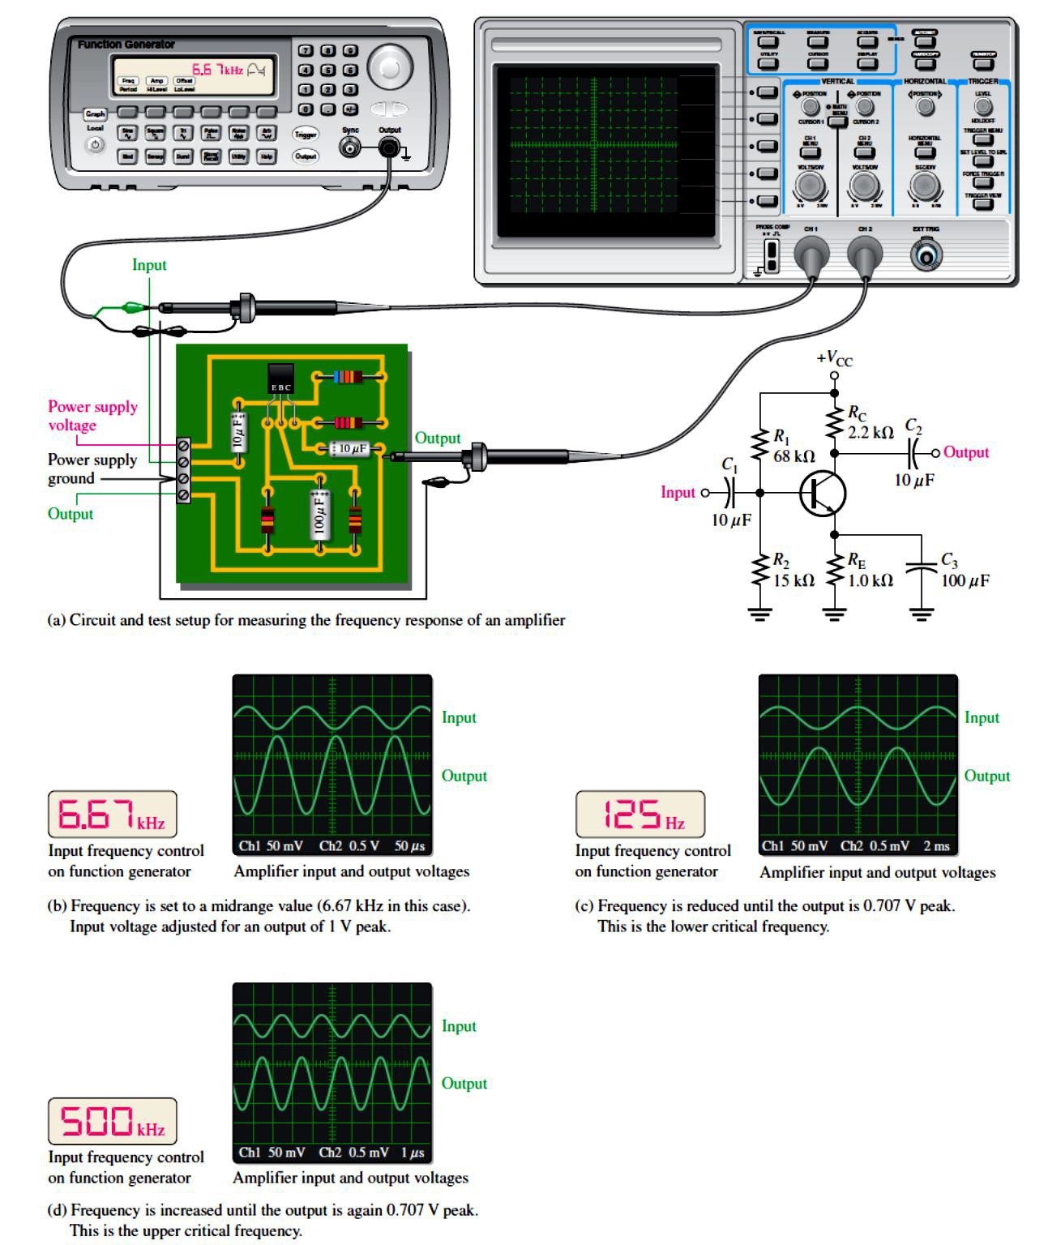
Step-Response Measurement: The lower and upper critical frequencies of an amplifier can be determined using the step-response method by applying a voltage step to the input of the amplifier and measuring the rise and fall times of the resulting output voltage. The basic test setup shown in Figure 10-50(a) is used except that the pulse output of the function generator is selected. The input step is created by the rising edge of a pulse that has a long duration compared to the rise and fall times to be measured. The rise time of the input pulse must be fast compared to the rise time we measure from the amplifier.
FIGURE 10-50: A general procedure for measuring an amplifier’s frequency response.

Slide 38
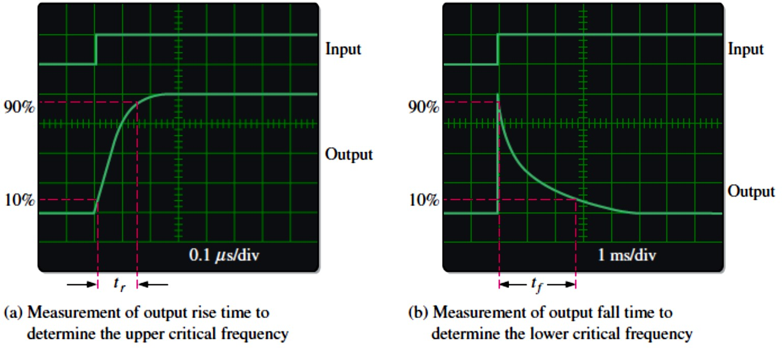
High-Frequency Measurement: When a step input is applied, the amplifier’s high-frequency RC circuits (internal capacitances) prevent the output from responding immediately to the step input. As a result, the output voltage has a rise time (𝑡� ) associated with it, as shown in Figure 10-51(a). In fact, the rise time is inversely related to the upper critical frequency (���) of the amplifier. As ��� becomes lower, the rise time of the output becomes greater. The oscilloscope display illustrates how the rise time is measured from the 10% amplitude point to the 90% amplitude point. The scope must be set on a short time base so the relatively short interval of the rise time can be accurately observed. Once this measurement is made, ��� can be calculated with the following formula:
��� =
�. ��
Equation 10– 31
�
�
FIGURE 10-51: Measurement of the rise and fall times associated with the amplifier’s step response. The outputs are inverted.
Low-Frequency Measurement: To determine the lower critical frequency (��� ) of the amplifier, the step input must be of sufficiently long duration to observe the full charging time of the low-frequency RC circuits (coupling capacitances), which cause the “sloping” of the output and which we will refer to as the fall time (��). This is illustrated in Figure 10-51(b). The fall time is inversely related to the low critical frequency of the amplifier. As ��� becomes higher, the fall time of the output becomes less. The scope display illustrates how the fall time is measured from the 90% point to the 10% point. The scope must be set on a long time base so the complete interval of the fall time can be observed. Once this measurement is made, ��� can be determined with the following formula.
��� =
�. ��
Equation 10– 32
�
�

